Slide 1
HSSE SHARING
SUBSTANCE ABUSE : MARIJUANA
By FARHAN AMRAN

Slide 2
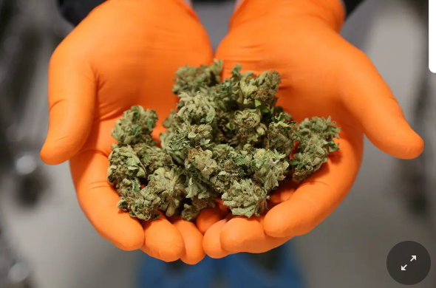
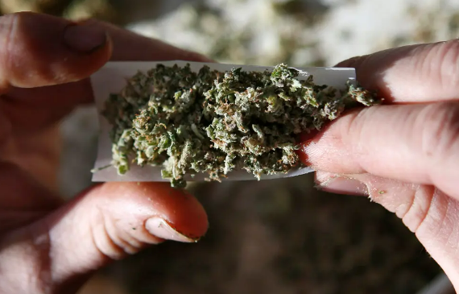
MARIJUANA
Crude drug composed of the leaves and flowers of plants in the genus Cannabis.
One of the most widely used illegal drugs.
Notes:
Negligence = carelessness

Slide 3
EFFECT OF MARIJUANA
LONG-TERM
• Psychotic symptoms
• Lung damage
• Worsen the symptoms of bronchitis
• Depressed immune system
SHORT-TERM
• Impaired Memory
• Loss of coordination
• Distortions in vision and hearing
• Sleepiness
• Red eyes
• Increased appetite
• Increased hear rate
Notes:
ERA = Ergonomics Risk Assessment

Slide 4
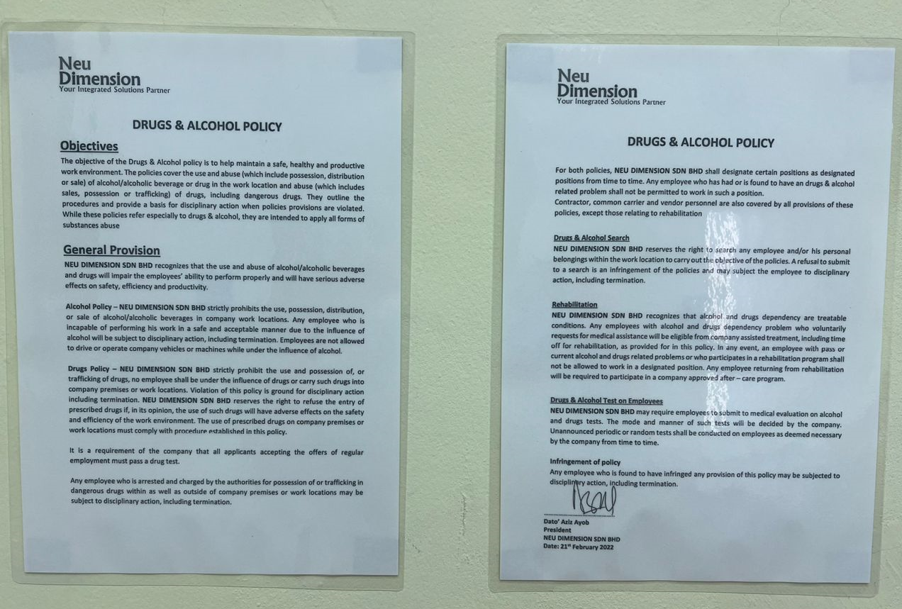
COMPANY POLICY

Slide 5

Thank you !
Questions and Answering Session
© Neu Dimension 2020

