Slide 1
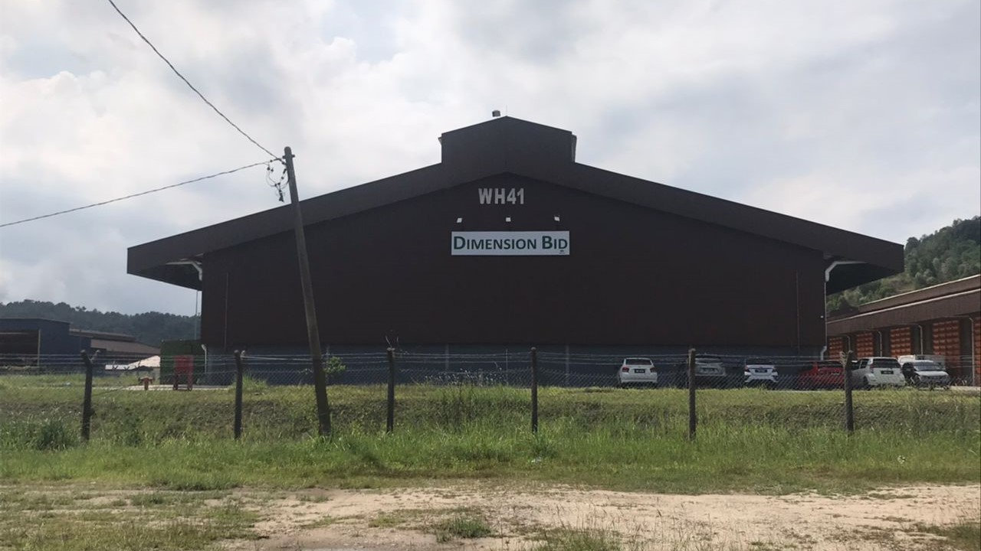
DIMENSION BID (M) SDN BHD
WEST MALAYSIA OPERATION (WMO)
Universiti Malaysia Pahang (UMP)
Fakulti Teknologi Kejuruteraan Kimia & Proses
1
DATE: 09 JUNE 2024
2
VENUE: DB WH41 & OPEN YARD 20
KSB, PHASE 2
INDUSTRIAL VISIT PROGRAM
3
TIME: 10.00A.M. – 5.00P.M.

Slide 2

AGENDA OF VISIT
VISIT TABLE OF CONTENT
HSSE BRIEFING
DB COMPANY PROFILE
01.
1. Safety Induction
02.
1. Company Profile
DB BUSINESSES
03.
Slickline Services (SLS)
Cased Hole Services (CHS)
Coiled Tubing Services (CTS)
04.
UMP SHARING
Faculty of Chemical & Process Engineering Technology
EQUIPMENT / FACILITIES
WALKABOUT
ANY OTHER BUSINESS
05.
06.
Coiled Tubing Services – Open Yard 20
Slickline Services - WH41
Question & Answer
Photo Session

Slide 3
Tentative Of Program
Industrial Visit at DB WMO 16/11/2023
10.00a.m. – 10.30a.m.
HSSE Briefing
10.30a.m. – 10.45a.m.
Introduction about company
10.46a.m. – 11.00a.m.
Break

Slide 4
11.00a.m. – 11.30a.m.
SLS Division Business Introduction
Open Yard 20
11.30 – 12.00p.m.
CHS Division Business Introduction
Open Yard 20
12.00p.m. – 12.30p.m.
CTS Division Business Introduction
Open Yard 20
12.30p.m. – 1.00p.m
UMP Information Sharing
Open Yard 20

Slide 5
1.00p.m. – 2.30p.m.
Lunch & Zohor Prayer
2.30p.m. – 3.30p.m.
CTS Division Facilities Walkabout
Open Yard 20
3.30p.m. – 4.30p.m.
SLS Division Facilities Walkabout & Tea Break
WH41
4.30p.m. – 5.00p.m.
Closing
Visit End

Slide 6

DB CTS DIVISION

Slide 7
INTRODUCTION TO CTU
DIMENSION BID (M) SDN BHD
COILED TUBING SERVICES

Slide 8
TYPE OF SERVICES
COILED TUBING SERVICE
Sand Cleanout Operation
PUMPING SERVICE
Bullheading Stimulation Chemicals
Nitrogen Unloading Operation
Milling Operation
Thru-tubing Operation (eg; Set Plug, Fishing, Open/Close SSD and etc)
Cementing Operation
Bullheading Well Kill/Temporarily Shut-off

Slide 9
Basic CT Equipment
Surface Equipment
CT Pressure Control Equipment (PCE)
TABLE OF
CONTENTS

Slide 10
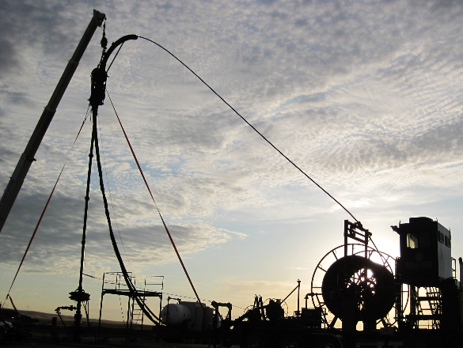
BASIC COILED TUBING EQUIPMENT
INJECTOR HEAD
CONTROL CABIN
PCE
REEL
POWER PACK

Slide 11
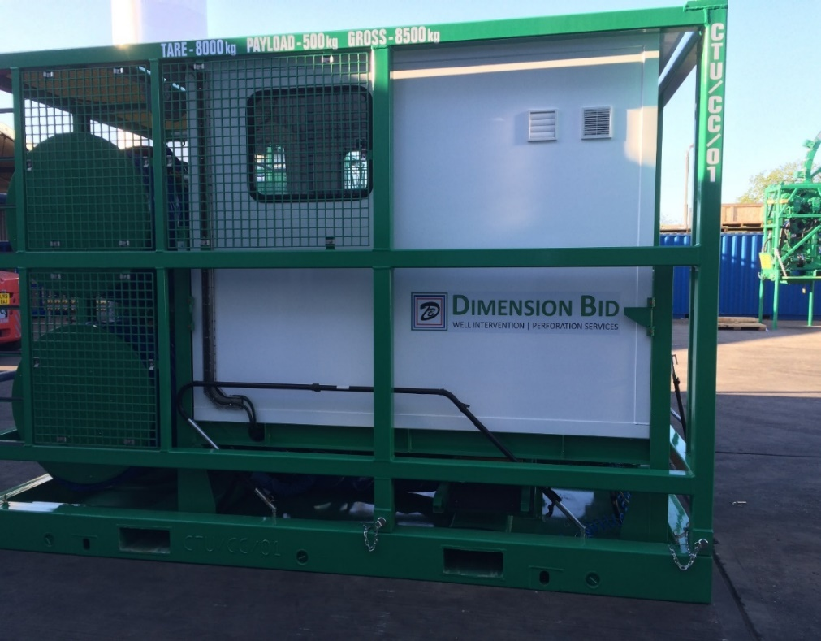
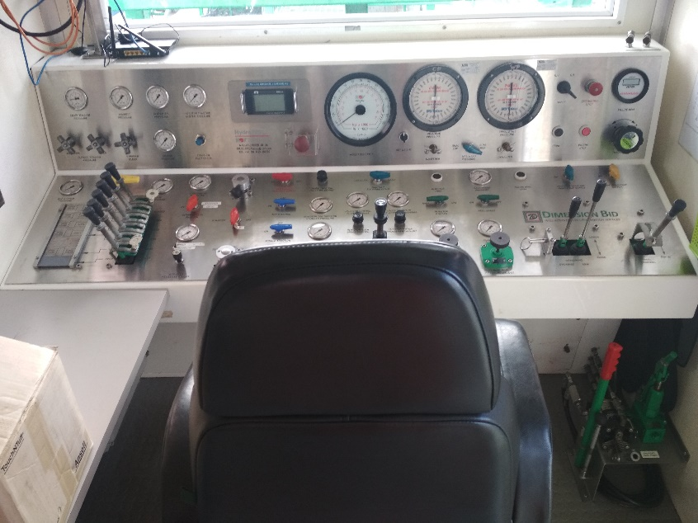
CONTROL CABIN
Primary control during CT operation.
  Reel controls
  Injector Head controls
  Stripper controls
  BOP controls
  Monitoring Instruments ( depth, weight, pressure, speed, pump rate)
  Monitoring Instruments (engine/hydraulic system)
  Accommodate hose reel
  Equipped with Orion V DAS

Slide 12
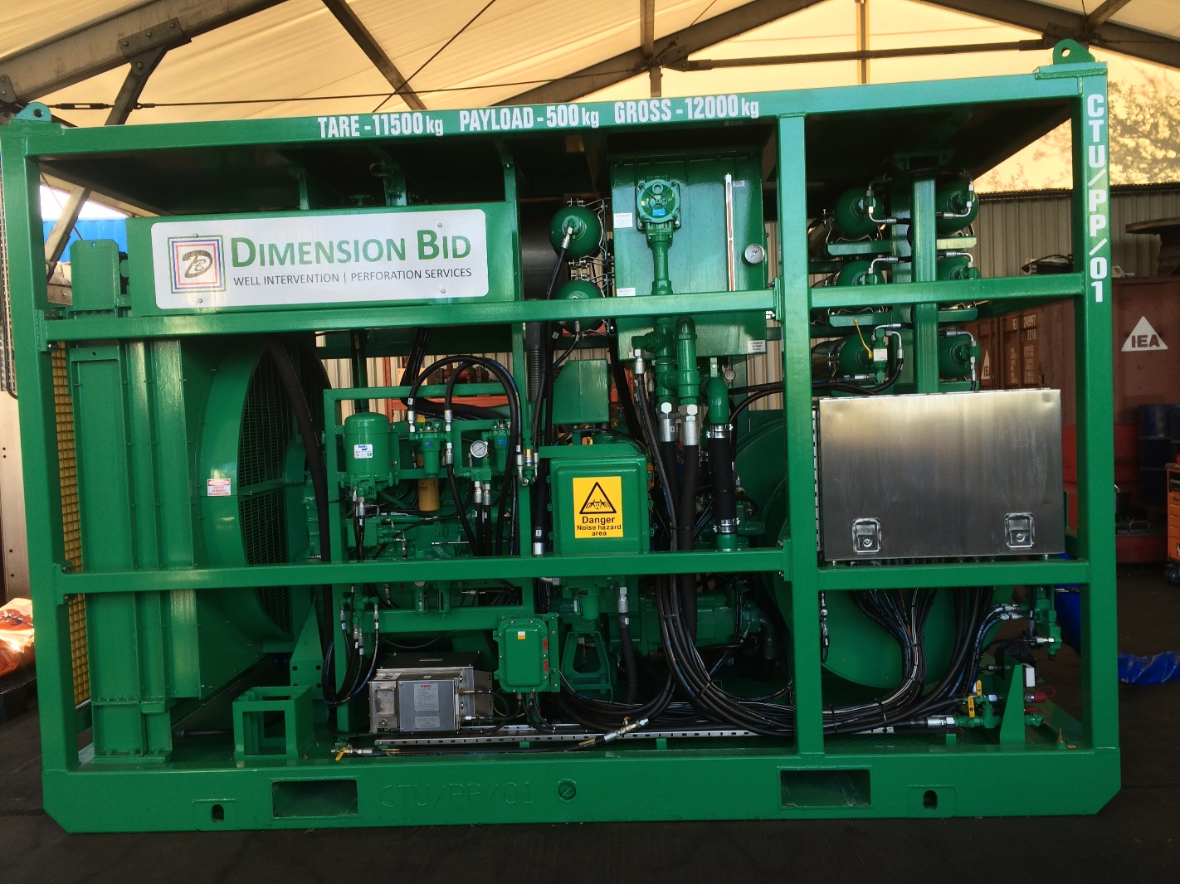
POWER PACK
Generate hydraulic and pneumatic power required by the other CT unit.
  Diesel Engine
  Equipped with air start system
  Drive hydraulic pumps to power individual systems
    Reel
    BOP
    Injector Head
    Leverwind
    Priority
    Auxilliary
  Accumulator for BOP as contingency

Slide 13
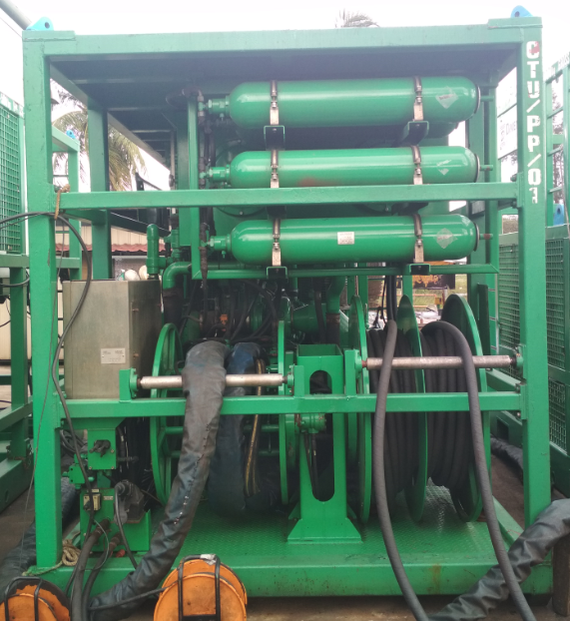
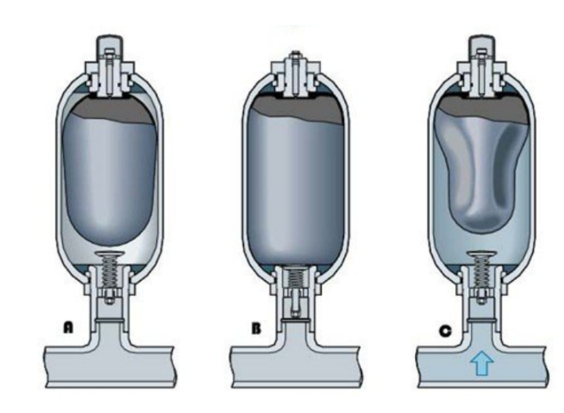
POWER PACK
Accumulator
  A storage bottle used to store energy
  CTU typically use a hydropneumatics accumulator
  These accumulators have a gas and a hydraulic compartment
  Bladder-type accumulators, charged with nitrogen gas, are the most commonly used type of accumulator on CTU
  The accumulator allows limited operation of the well control equipment following engine shutdown.
  The BOP supply is a dedicated supply for controlling the BOP functions only.
  The circuit pressure will vary between 2,700 and 3,000 psi during normal operation
  The accumulator is pre-charged with nitrogen to 1,400 psi
  This accumulator stores hydraulic power, allowing limited operation of the BOP following shutdown of the power pack.

Slide 14
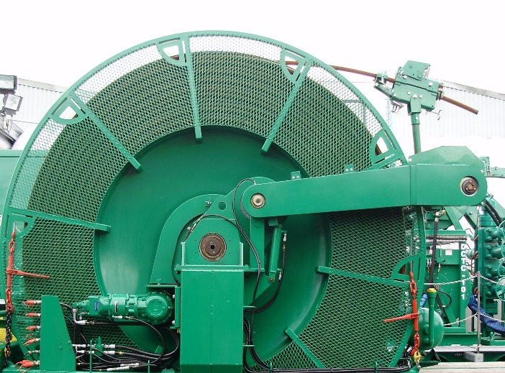
CT REEL
Provided the force to spool CT in and out from the reel
  Swivel Joint – Continuous pumping while rotating the reel
  Reel Manifold – Allow drop balls
  Lever Wind – Assist CT to be in safe position during RIH and POOH
    Horse Head
    Mechanical Depth Counter
  Specification
    72” Core
    120” Spool OD
    72” Spool width
    Spool capacity: 16,000ft x 1.50” tubing

Slide 15
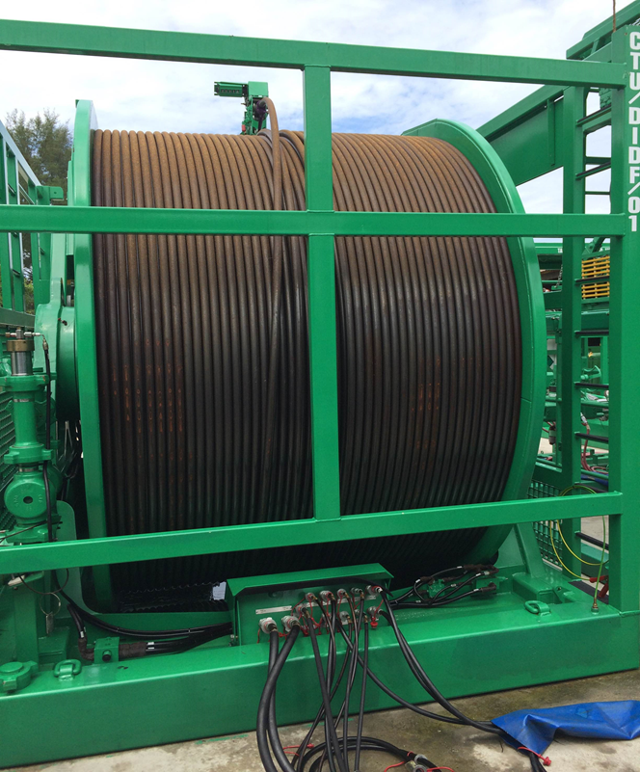
CT STRING
CT String
  Materials : High Strength Low Alloy Steel (HSLAS)
  Various size of CT. (1”, 1.25”, 1.5”, 2.0” & etc)
  Types of CT String
    Non-Tapered String
    Tapered String
  Types of Weld
    Butt Weld
    Bias Weld

Slide 16
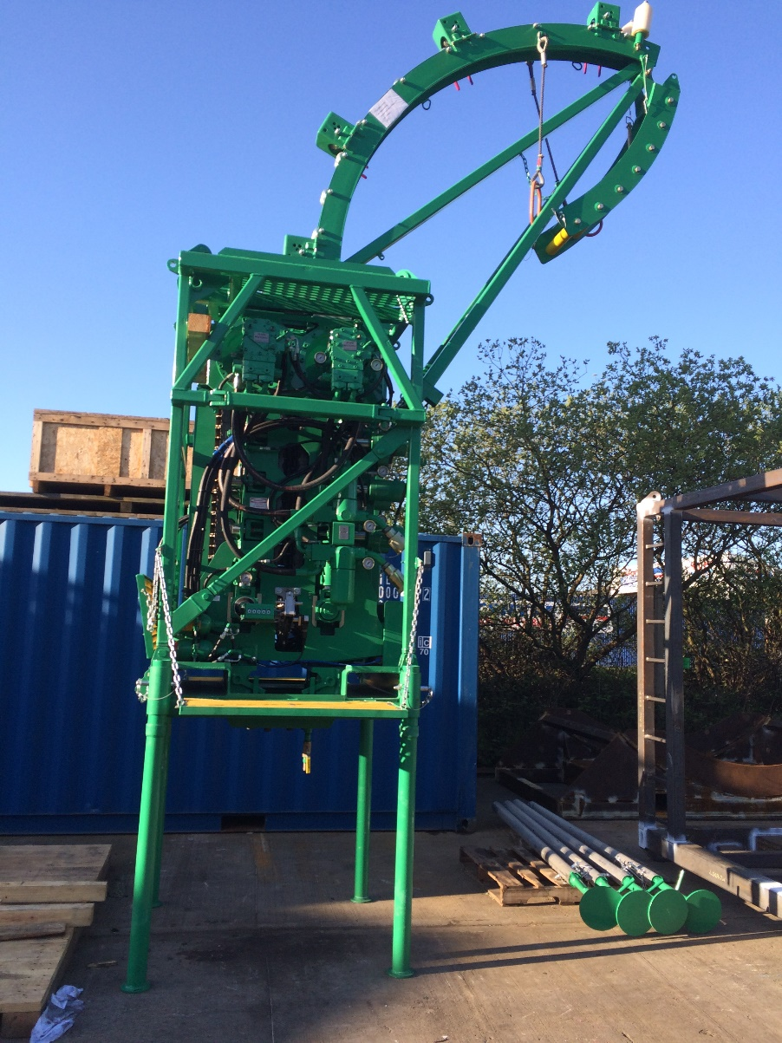
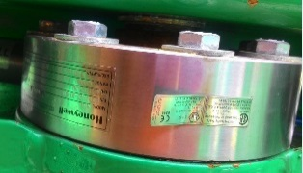
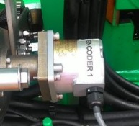
INJECTOR HEAD
Basic functions of the injector head includes:
  Injecting and retrieving the CT string (chain drive system)
  Holding the CT string static (chains and braking system)
  Guiding the CT from the reel (gooseneck)
  Tension / compression measurement (weight indicator)(Load Cell)
  Depth / speed measurement (depth system sensor)
  Mounting place for primary pressure barrier (stripper)

Slide 17
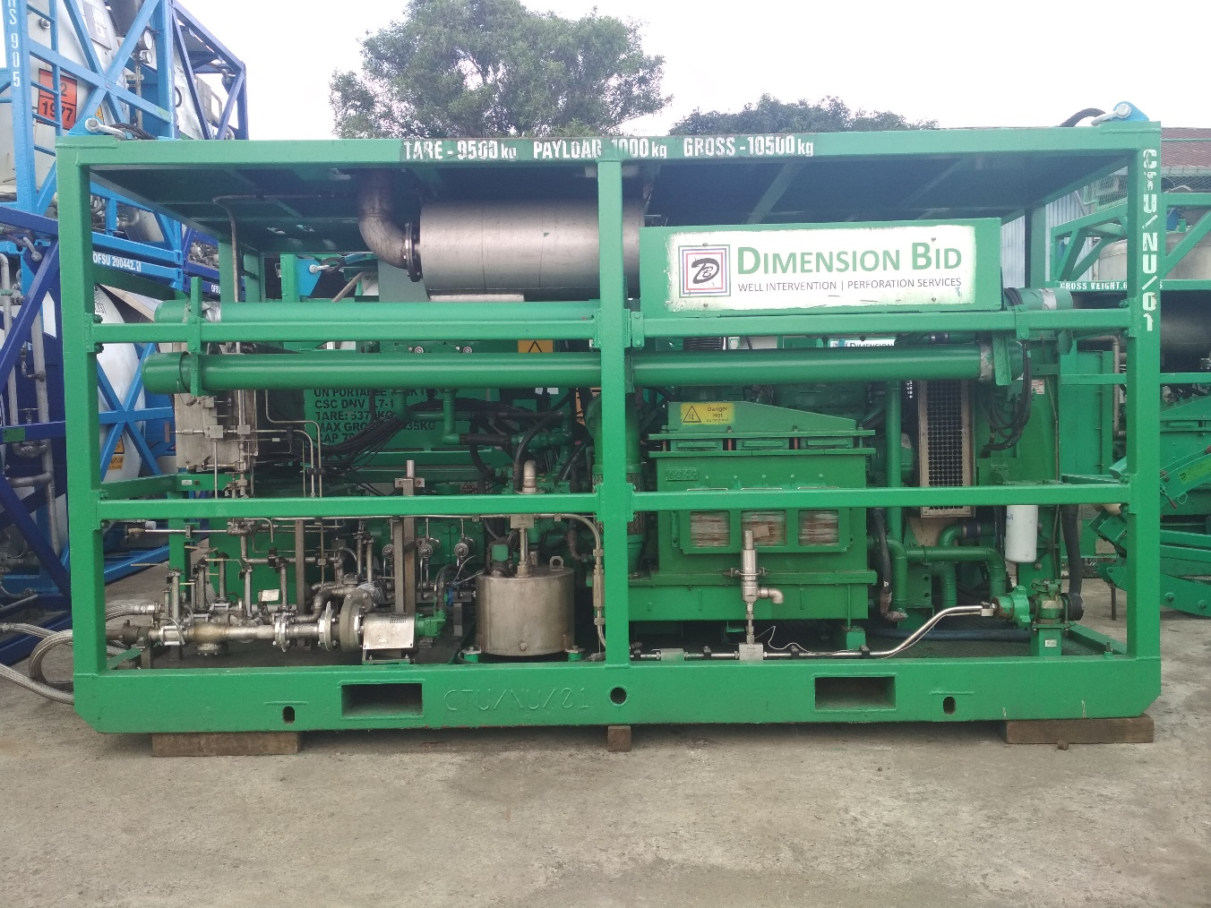
NITROGEN CONVERTER
To Convert Nitrogen From Liquid To Gas
  Vaporizer absorb heat from coolant loop circuit to convert nitrogen from liquid to gas
  Equipped with air start system
  Type 180k
  Capable to convert up to 3000scf/min
  Fluid end pressure rating is 10,000 psi

Slide 18
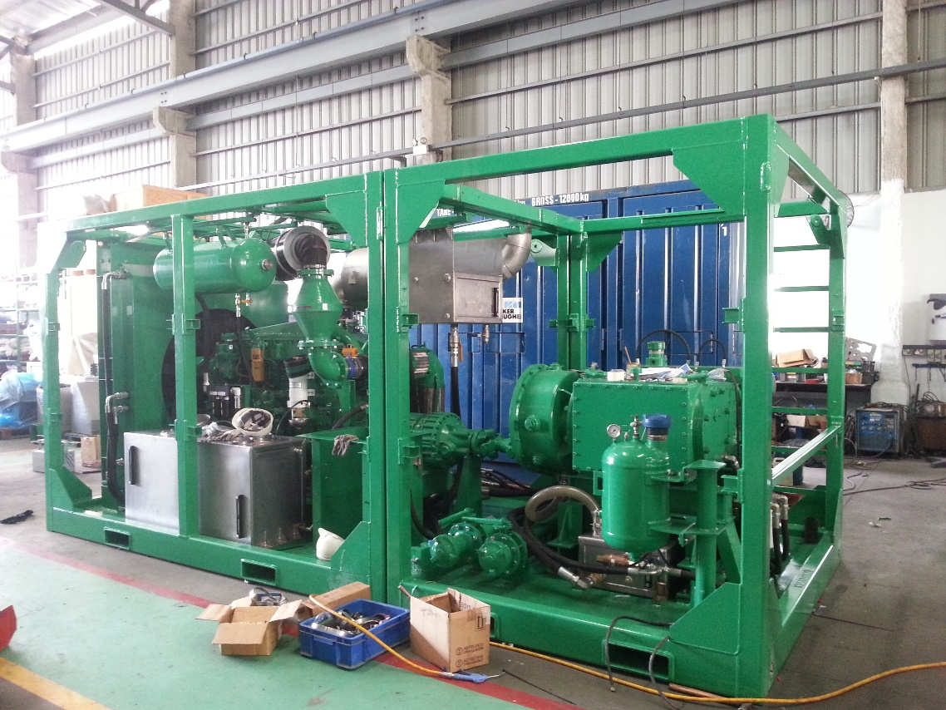
SINGLE PUMP
Basic Functions of the Single Pump:
  To pump fluid at high pressure by convert rotational power into reciprocating power
  Equipped with air start system
  3 sizes of plunger
    2.75”
    3.00”
    3.50”

Slide 19
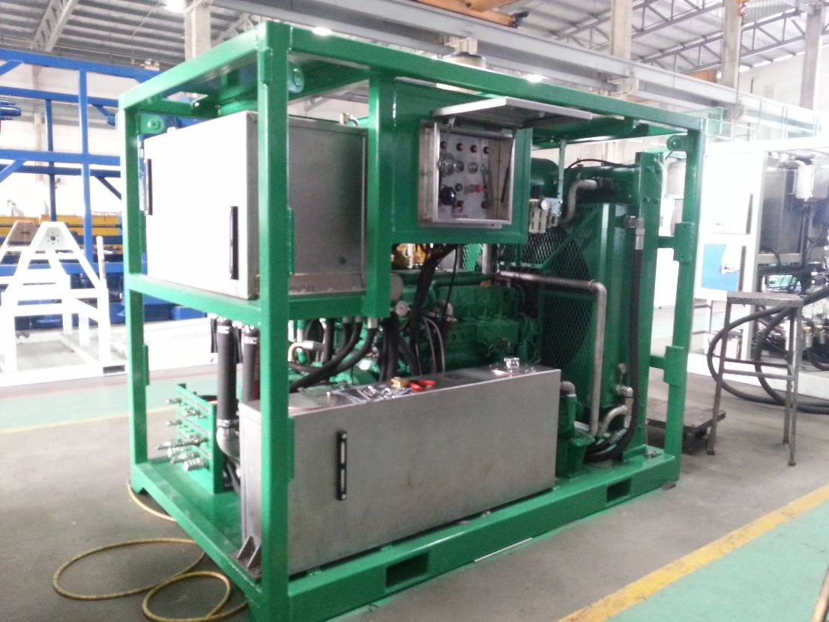
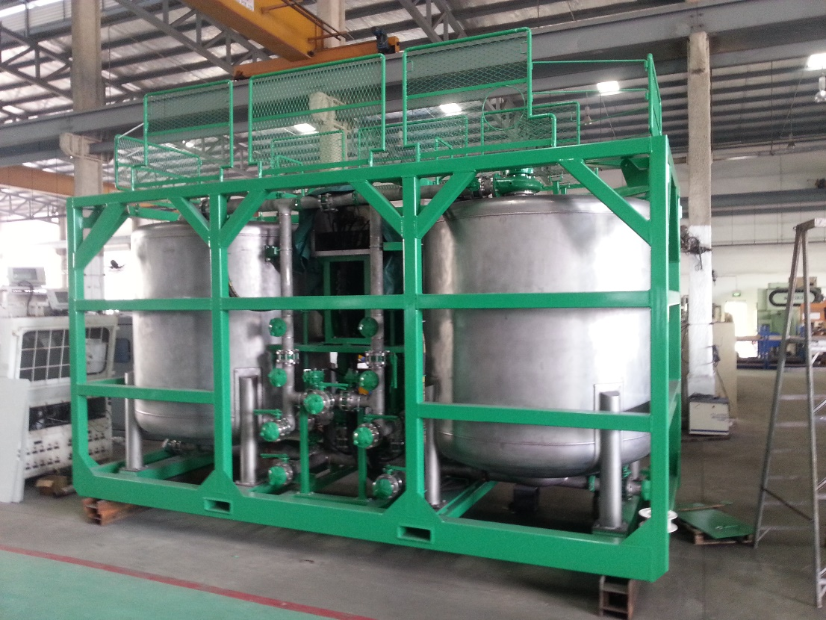
BATCH MIXER

Slide 20
BATCH MIXER
To mix any fluids during operation
  Batch Mixer Power Pack
    Equipped with air start system
    Supply hydraulic to batch mixer tank in order to operate c-pump and agitator
  Batch Mixer Tank
    Consist of 2 tanks (Total 100bbls)
    Assist by 5x6 c-pump
    Has agitator to agitate the mixture fluid

Slide 21
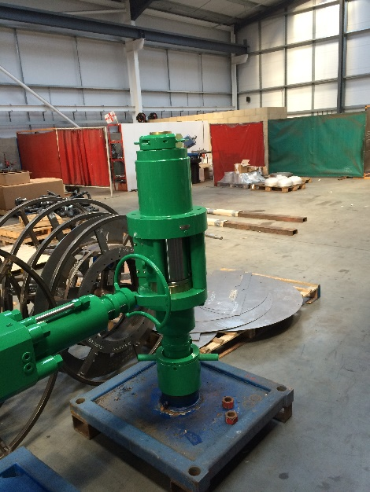
PRESSURE CONTROL EQUIPMENT
Stripper
  To provide an annular seal around the CT string
  Primary well control barrier
  Types of Stripper
    Conventional
    Side Door
    Radial

Slide 22
PRESSURE CONTROL EQUIPMENT
Stripper
  Energize remotely from the control cabin
  Hydraulic pressure is applied to the underside of a piston, forcing it upward into the stripper element, which compress around the tubing, creating the seal

Slide 23
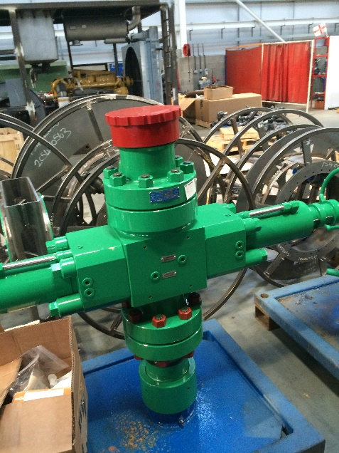
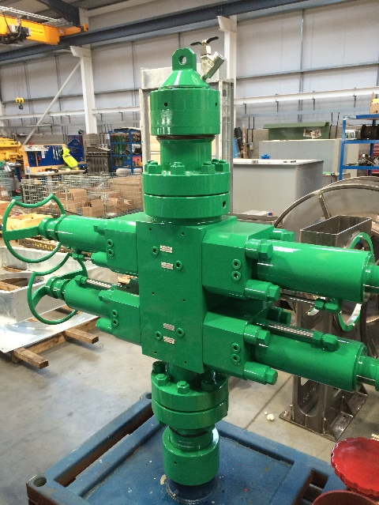
PRESSURE CONTROL EQUIPMENT
Blow Out Preventer
  Types of BOP :
    Single BOP
    Dual Combi BOP
    Triple Combi BOP
    Quad BOP
  BOP Ram insert depend on type of BOP
    Pipe, Slip, Shear & Blind Ram Inserts.

Slide 24
THANK YOU

Slide 25
Q & A SESSION
(PROGRAM CLOSING)

