Slide 1
Pressure Controlled Equipment (PCE)
Module 08
JFE Learning Material Package

Slide 2
Course Outline…
Learning Outcome
Introduction
Pressure Definition
Job Planning
PCE Component
PCE Connections
Slickline Well Barriers
PCE Equipment Identification & Certification
Wellsite Pressure Testing
Safety Consideration
Summary
References
Q&A

Slide 3
By the end of the course, JFEs should be able to:
Explain on the pressure definition and differentiate every one of it.
List out job planning prior to slickline operation
Explain the basic principle and application of PCE component.
List down type of PCE connection and identify the measurement.
Describe about PCE identification, certification process and use of approved equipment.
Describe in detail on Wellsite Pressure Testing and hazards involved.
Describe safety consideration in PCE operation and general PCE safety rules.
List the dangers associated with pressure operation.
Summarize the pressure test policy

Slide 4
INTRODUCTION

Slide 5
Introduction
The majority of blowouts and pressure related incidents are caused during well intervention, using equipment and techniques such as slickline, CTU, snubbing or workover rig operations.
Efficient, safe slickline operations are essential, but can only be achieved through good planning and implementation of correct procedures.
The use of appropriate tools and correctly maintained equipment is an integral part of successful, safe, slickline operations. The necessary skills and operator competency are a result of thorough theoretical education and practical training.
Supervisors and operators should be fully aware of the constraints imposed during slickline operations. The most significant of these is that the operator is essentially working ‘blind’, and must rely on surface indications and observations to ‘sense’ the functioning of his tools.
This may be difficult when the tool being used is several thousand feet down a wellbore, at the end of a relatively thin wire and possibly in heavy mud or thick crude oil.

Slide 6
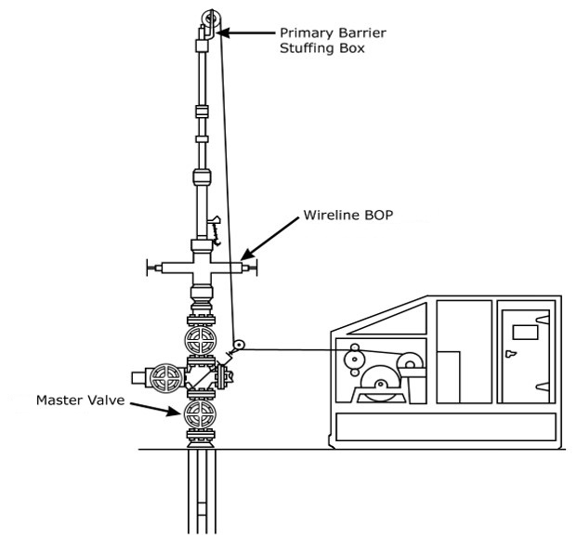

Slide 7
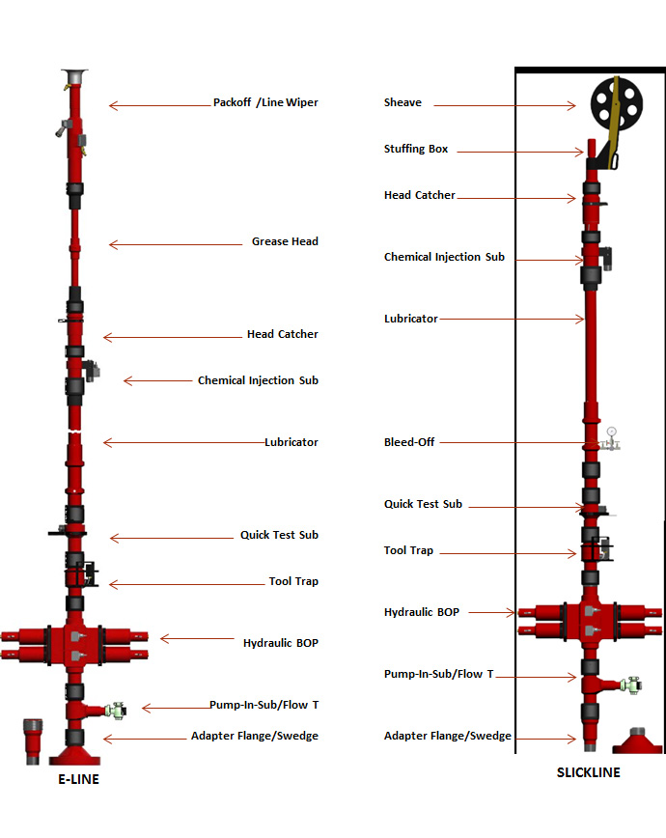

Slide 8
Pressure Definition
WHP - Well Head Pressure: is the pressure value measured at the wellhead whatever the pressure source.
WP - Working Pressure: is the equipment’s maximum pressure rating, by design. This Must Never, be exceeded in wellsite operations.
TP - Test Pressure: is the pressure value at which, by design, the equipment must be submitted to qualify for operational suitability.
MPWHP - Maximum Potential Well Head Pressure: is the maximum pressure, flowing or shut-in, that the wellhead could face during operations based either on down hole reservoir pressure or surface pumping capacity.
MAOP - Maximum Allowable Operating Pressure: must be equal to the Wellsite Test Pressure.
Surface Induced WHP - The WHP that is generated by a source that is at surface.
Reservoir Induced WHP - The Wellhead Pressure that is generated by the reservoir.
Surface Control WHP - The Wellhead Pressure that whatever its origin (surface or reservoir) can or could be bled down to zero psi at anytime, and WHP will remain stable at zero psi.

Slide 9
Job Planning
Equipment must be suitable for the type of operation
Pressure rating
Working pressure / Test pressure
Safety factor
Service type
Standard service and H₂S service
Main components
Ancillary components
Equipment selection
Factor affecting changes in rig up
Hoisting methods
Wire selection

Slide 10
Job Planning
Job design of Pressure Control Equipment for Slickline operations would be as per below:
The choice will be made according to:
  Well head pressure origin.
  Well head pressure actual or possible value.
  Working environment.
  Type of operation.
Pressure Operations are divided into 3 different operating conditions:
  Surface Induced and Wellsite Controlled with WHP > 1 psi
  Reservoir Induced with WHP = 0, but contingency cases could lead to a WHP > 1 psi
  Reservoir Induced Pressure with WHP > 1 psi

Slide 11
Safety Factor
Used to select correct WP rated equipment with reference to MPWHP
MPWHP is the maximum potential well head pressure
Also used when performing pressure tests at the wellsite
Factor of safety = 1.2
Example - if MPWHP = 4500psi, then 5000psi equipment cannot be used
4500 x 1.2 = 5400psi, therefore 10000psi WP would have to be used

Slide 12
PCE COMPONENT

Slide 13
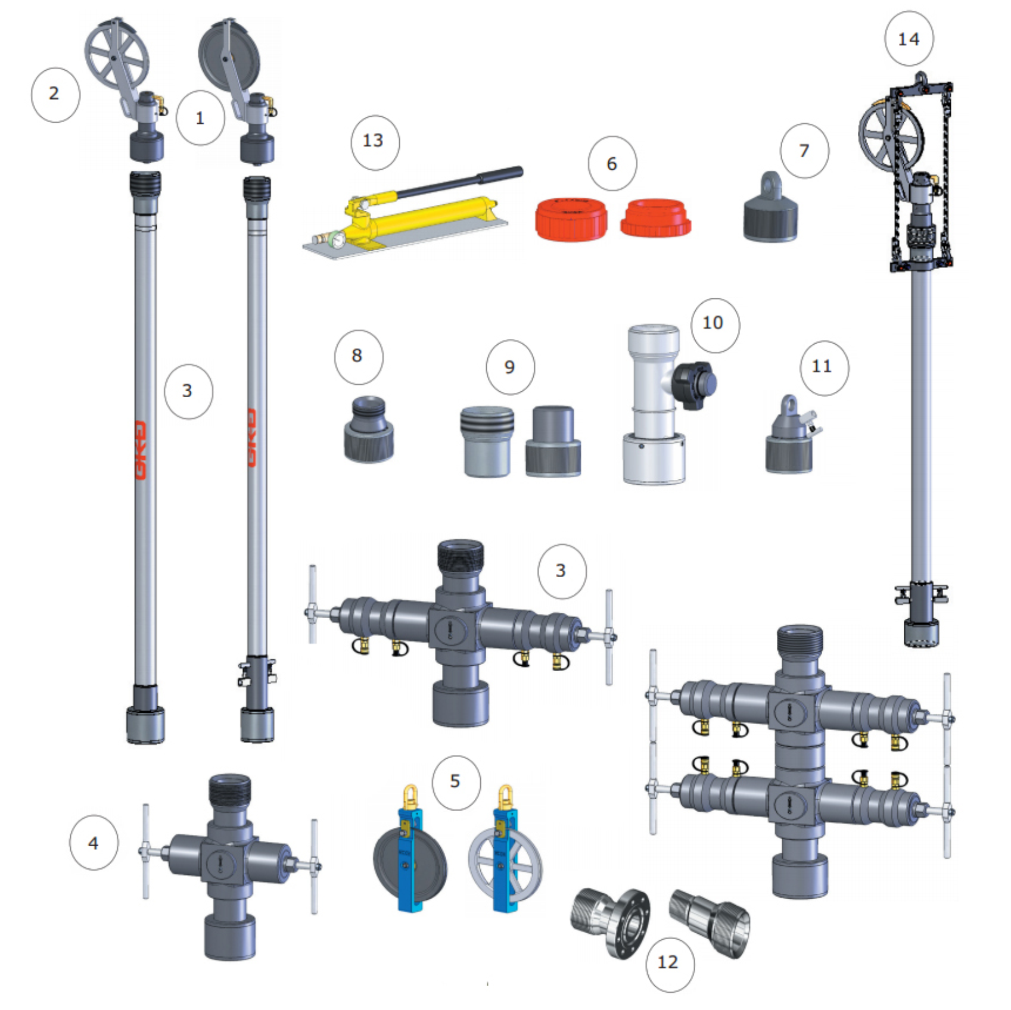
PCE Component
Slickline Pressure Control String
High Pressure Hydraulic Stuffing Box (with Composite or Aluminium Sheave)
Lubricator (with or without 1/2" Bleed/Pump-in Ports)
Wireline Blowout Preventer (Manual or Hydraulic, Single or Twin)
Hay Pulley (with Composite or Aluminium Sheave)
Thread Protector (Box or Pin)
Pick-up Sub
Quick Union Changeovers / Crossover Adapters
Test Cap (Box or Pin)
Pump-in Sub
Ported Night Cap
swage or Flange Adapters
Hydraulic Hand Pump (BOP or Stuffing Box)
Lubricator Lifting Clamp

Slide 14
Stuffing Box
Is a active well barrier “seals while wire is moving or stationary”. This is the primary barrier for slickline intervention.
It is a closed type barrier and the first equipment in the pressure barrier system.
The Slickline stuffing box must be equipped with a plunger or ball check in which it will close when the line breaks in hole
Hydraulic stuffing boxes must be used when H2S is present.
It allows slickline to be run through it and at the same time the sheaves has a safety feature to catch the wire just in case it snaps so that the wire will not flail around.

Slide 15
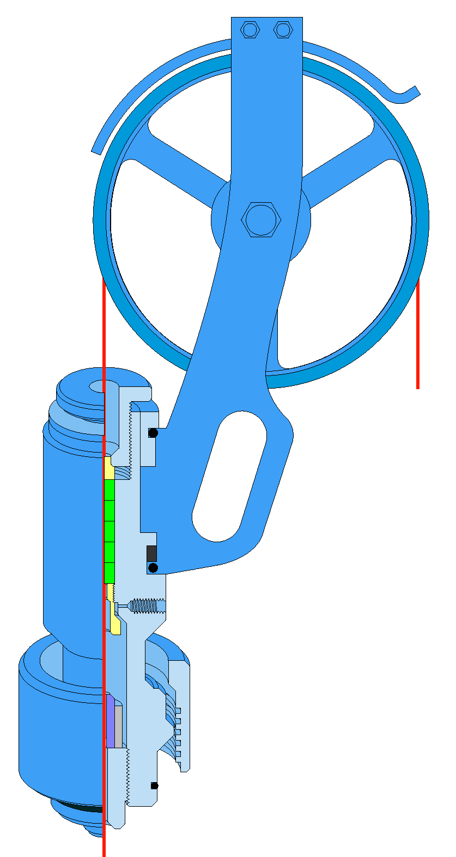
Stuffing Box (Manual)
Sheave Guard
Sheave
Manual Nut
Upper Gland
Staff
Cylinder Packing
Lower Gland
Blow out Plunger

Slide 16
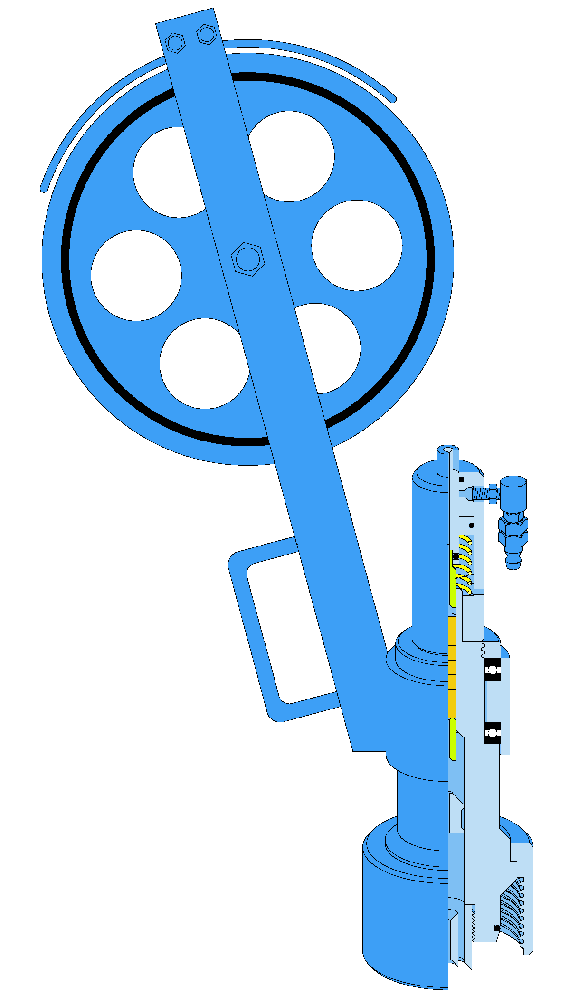
Stuffing Box (Hydraulic)
Sheave Guard
Hydraulic Packing Nut
Upper Gland
Cylinder Packing
Staff Bearings
Lower Gland
Blow out Plunger

Slide 17
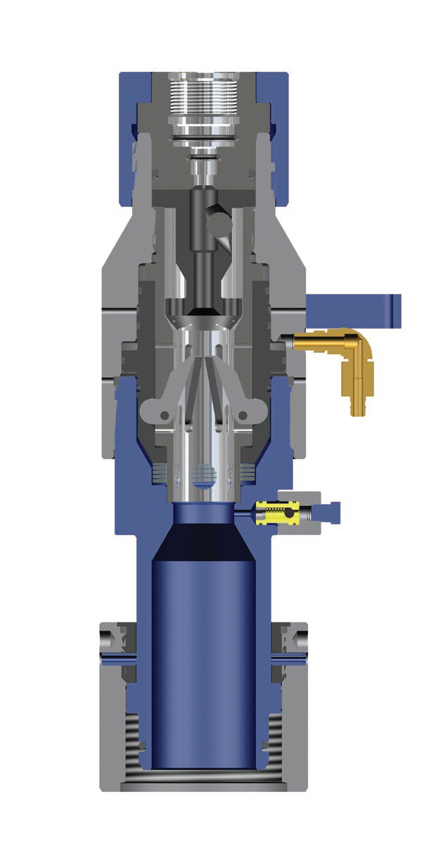
Tool (Head) Catcher
Is primary a safety device, designed to catch the toolstring if it is drawn into the lubricator rig up to quickly and hits the top.
Should be used on Semi-Submersibles or Floaters.
The tool catcher must be remotely operated.
Dogs need to be changed to fit the correct size of fishing neck.
Is placed under the stuffing box.

Slide 18
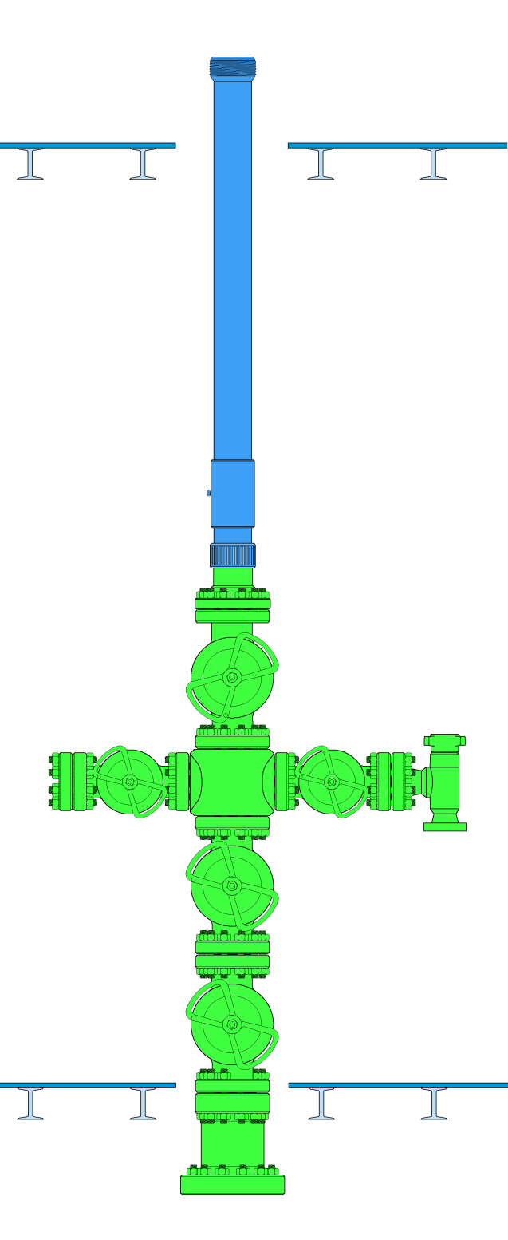
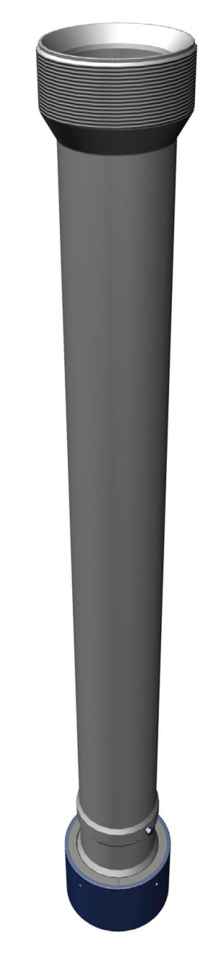
Lubricator / Riser
“Tubes” which contain toolstring and equipment to be run.
Available in full range of working pressures (WP) 5K, 10K, 15K with a Quick Union connections
Available with bleed off ports
  Ported
  Non ported
3 basic types
  Conventional
  Lightweight
  Integral
The number of lubricators selected must be ensured to allow sufficient length to contain the complete toolstring plus an additional 3ft.
Definition of Riser - spacer lubricator from Christmas Tree to work level (normally main deck)
Handling riser during rig up and rig down is very critical. Communication must be established during the change out.

Slide 19
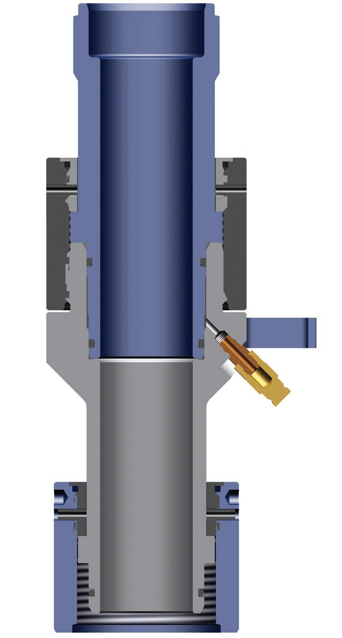
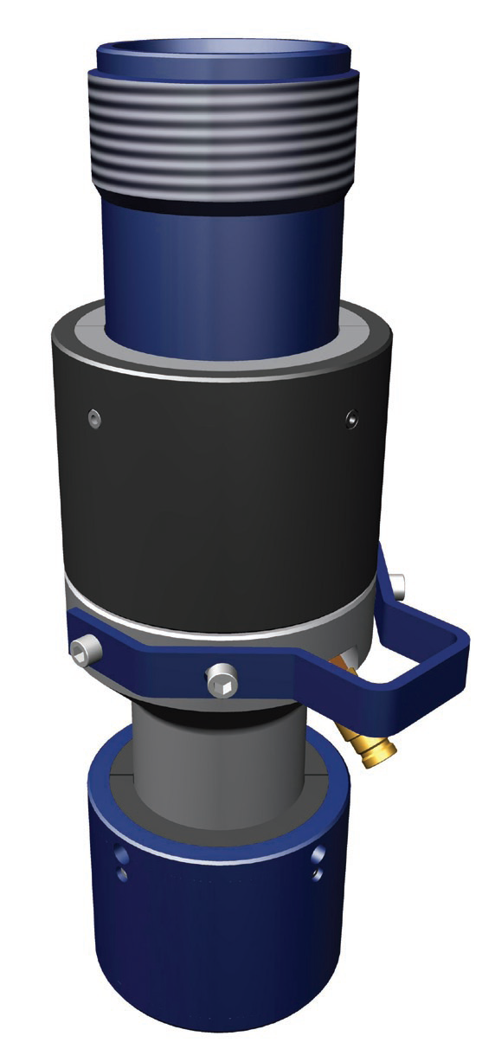
Quick Test Sub
Inserted in the rig up at the position of the joint normally opened to insert and retrieve tools from the well.
Subsequent pressure tests can be made using the Quick Test Sub to verify the integrity of the union that has been disconnected, rather than having to test the complete rig up.
Must be used during perforating operations.

Slide 20
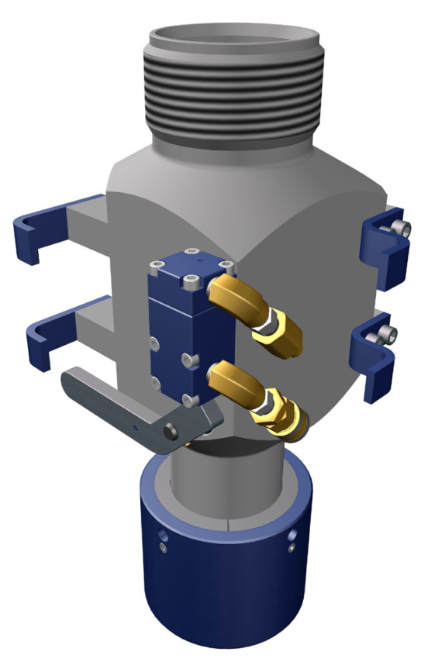
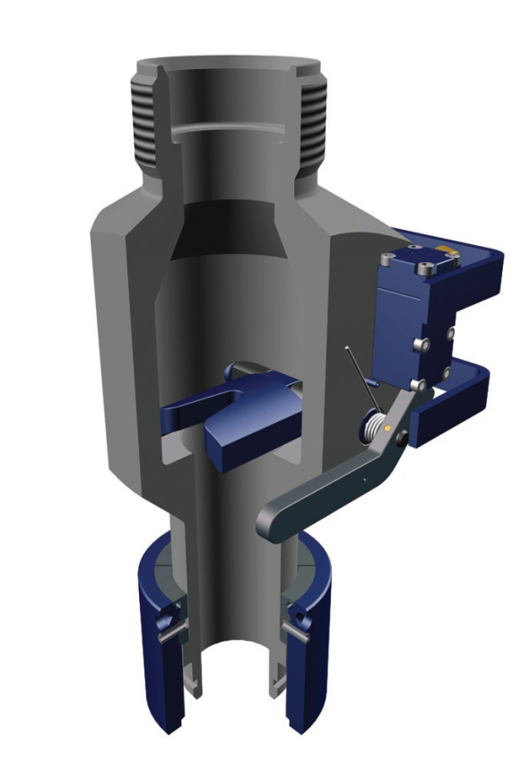
Tool Trap
Safety device installed above the wireline valve.
Flapper check for the toolstring in case tools are pulled into the SB, out of the rope socket.
Two flappers in through bore
Indicator arms
Can be manual or hydraulic (must be hydraulic when H2S is present)
Safety – Care when lowering tools

Slide 21
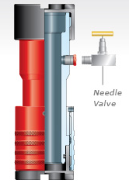
Bleed Sub
A bleed sub is used for applications up to 10,000psi WP Standard or Sour Service, when a bleed off port is required on the pressure control equipment rig up.
For PCE rated above 10,000psi WP, the bleed-off valve must be part of the wireline valve block manifold.
Some have 2 ports

Slide 22
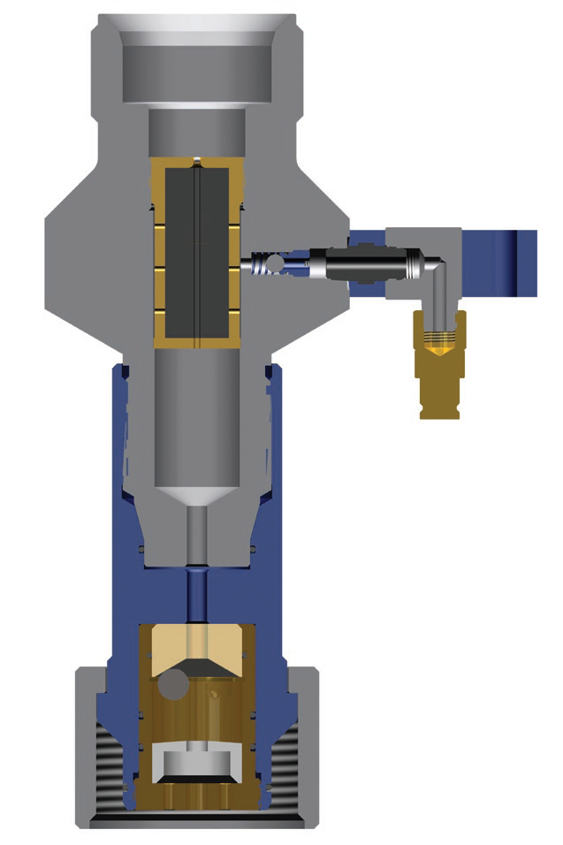
Chemical Injection Sub
Is designed to apply a de-icing agent, corrosion inhibitor, or to lubricate slickline during well service operations.
Is recommended on High Pressure dry gas wells due to the drying effect on the stuffing box packing and the slickline.
Is placed under the stuffing box.
Can act as a fluid barrier between the well and the stuffing box, thus preventing hydrates from forming and “icing up” the stuffing box.

Slide 23
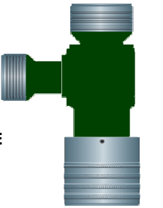
Pump in Sub
Pump in sub are used to pump in fluids into the well. Must be used when no lateral or flow line valve is present.
Allows client to kill well if needed.
When placed below lowest pressure barrier:
  Lateral entry must be integral or connected with API6A flange.
  Must be connected to gate type valve with API6A flange. Plug valves allowed up to 5000psi WP.
  Hammer unions are only permitted after gate/plug valve.
When placed above lowest pressure barrier:
  Lateral entry can be connected with 1502 Hammer Union.
  2” 602 hammer unions are forbidden.

Slide 24
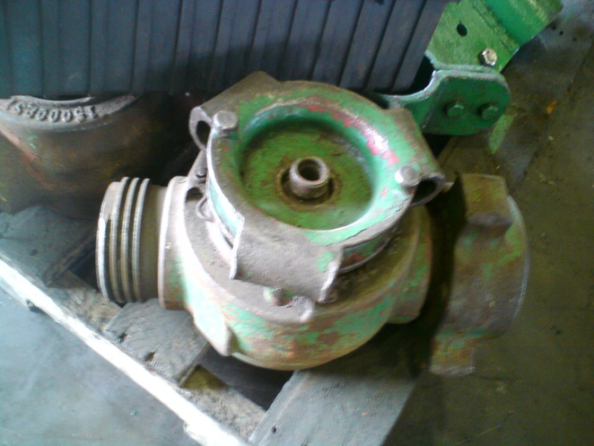
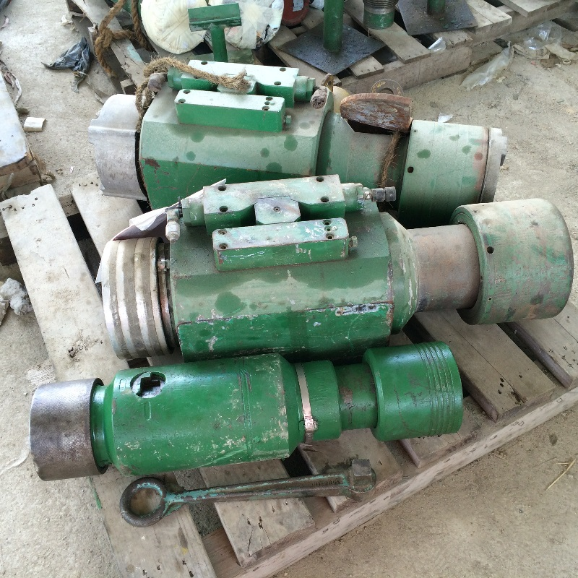
Low Torque Valve & TIW Valve
Low Torque Valve
Texas Iron Works (TIW) Valve

Slide 25
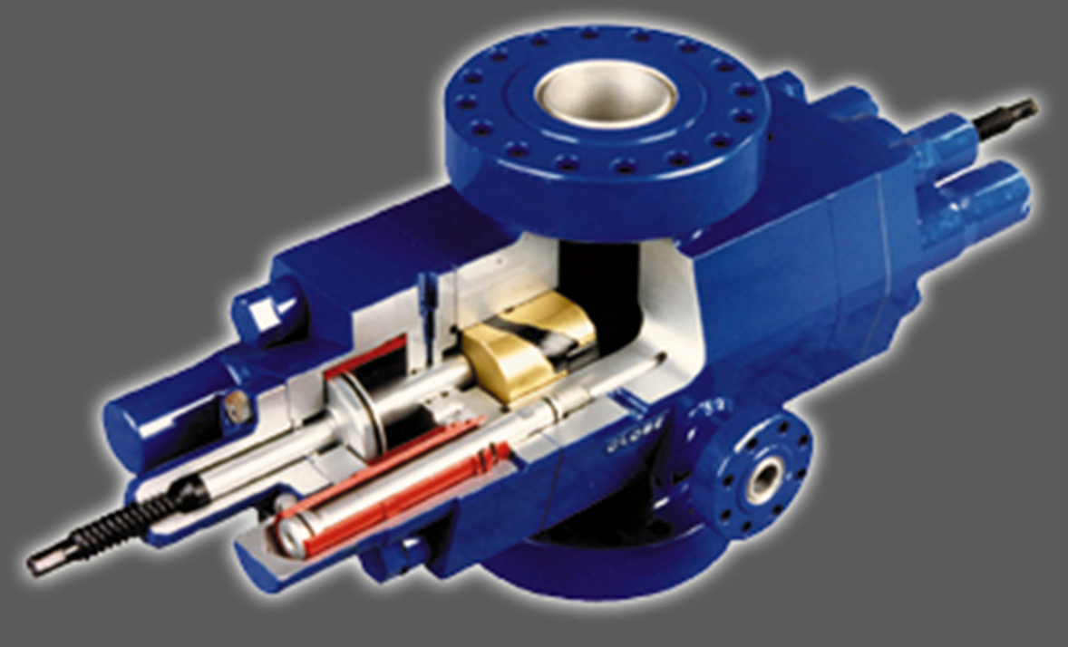
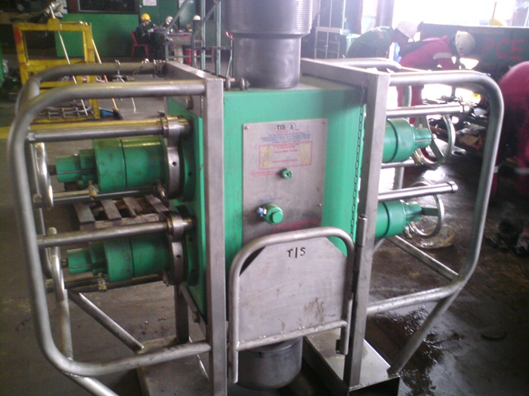
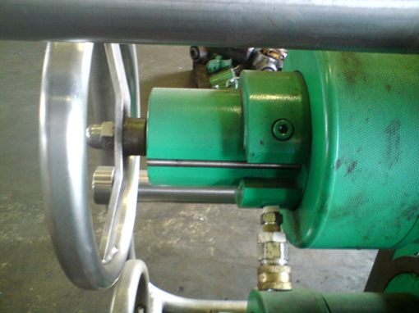
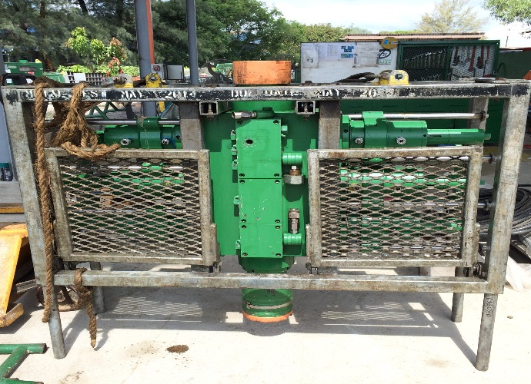
Wireline Valve (BOP)
BOP is a closable type barrier capable of closing around the wire and seal well pressure. It is a passive well barrier “provides facilities for contingencies and emergency procedures”.
Must be installed on all rig ups. Can be activated manually or hydraulically
Different ram configuration and choices dependant on well conditions and operation
Rams can only hold pressure from only one direction.
Wireline Valve must be in the close position during transportation, after rig down, storage ...etc.
Wireline Valves equipped with “shear and seal” rams must be placed below the rams capable of sealing on the cable/wire.

Slide 26
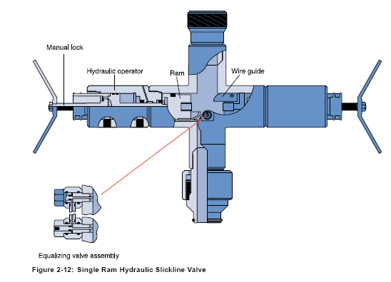
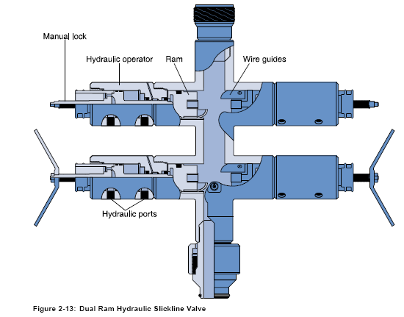
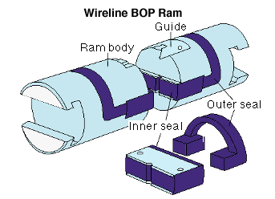
Wireline Valve (BOP)

Slide 27
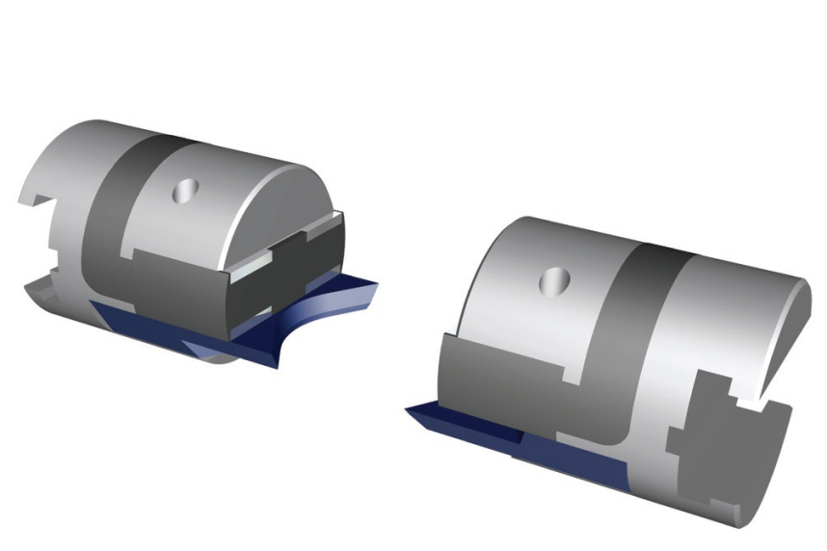
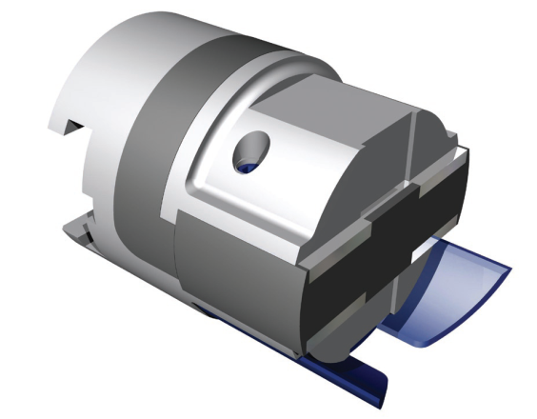
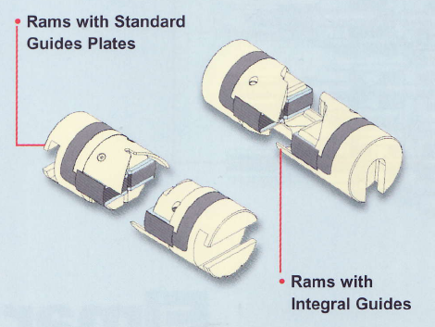
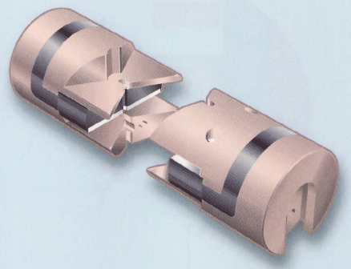
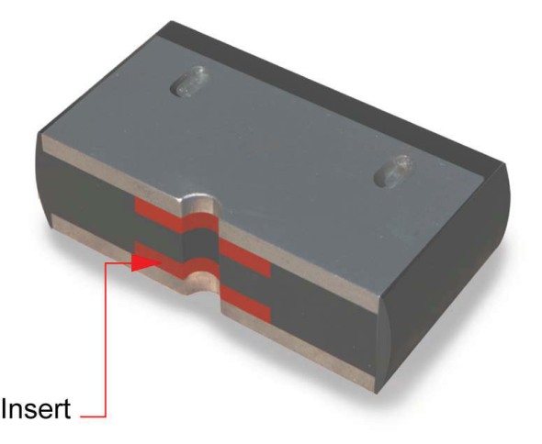
Wireline Valve (BOP)
Slickline Ram
Shear and Seal Rams
Q-Guide Rams
Multiline Inner Seal

Slide 28
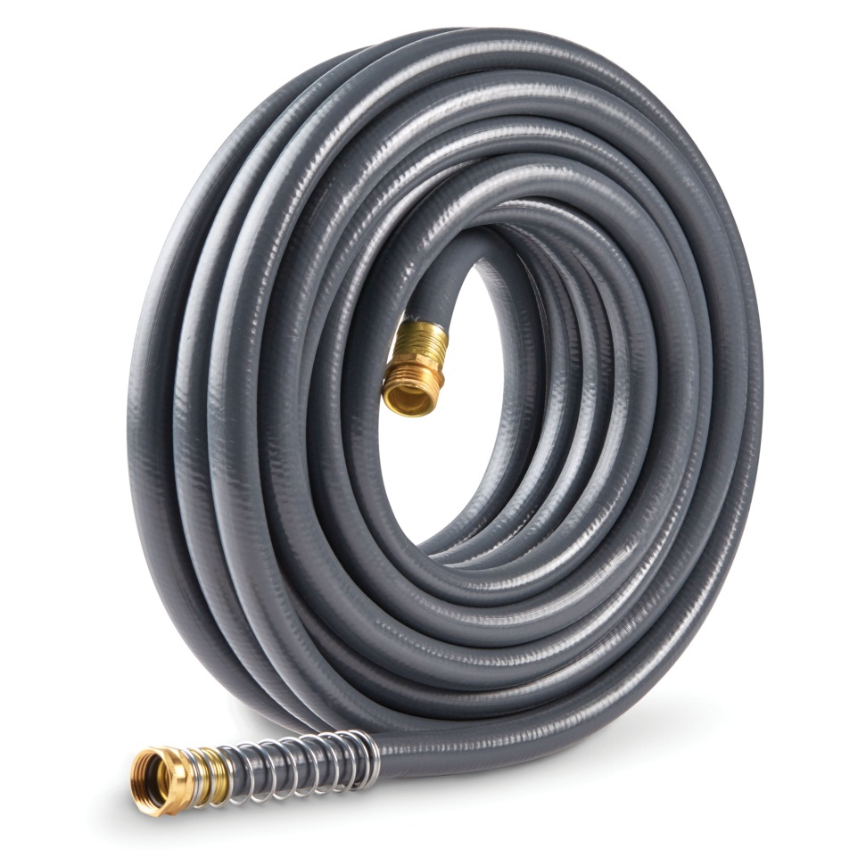
Flexible and Bleed Hoses
All hoses have a WP, TP and Burst Pressure rating
Hoses must meet SAE codes for different fluid types
No Braises connection allowed. Above 10K, engineered fittings must be utilized
As a minimum, each hose has to have a stainless steel tag indicating the WP and the manufactures part number
Must be tested to manufactures TP or 1.5 x WP at reception
Test pressure is according to manufactures specifications or 1.5 x WP of hose
Burst Pressure safety factor is 2.5 x WP up to 15,000 psi. WP. All though 4 is recommended
If a lubricator/riser bleed off hose is utilized; it must comply with the same specification requirements as set for flexible hoses

Slide 29
PCE CONNETIONS

Slide 30
PCE CONNETIONS
Most pressure control equipment utilizes the Quick Union connection.
Sealing of the Quick Union is not dependant on how tight the connection is.
The seal is made by an internal O-Ring on the pin end sealing in the box end of the union – Not by the threads. The O Ring in the Quick Union connection retains the pressure.
QU are self aligning due to the profile of the box and pin section.
The two ends are kept together by a knurled collar resting on a shoulder on the pin end, and screwing onto the external thread on the box end.
ACME threads are used.

Slide 31
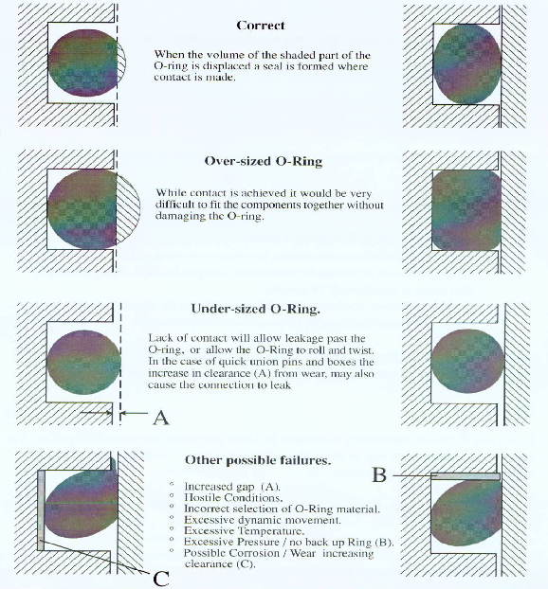
O-Rings
Selection of Oring depending on below:
O Ring material
Sizing of O ring
Sealing faces
Back up rings
Non extrusion rings
Tolerance of pin/box

Slide 32
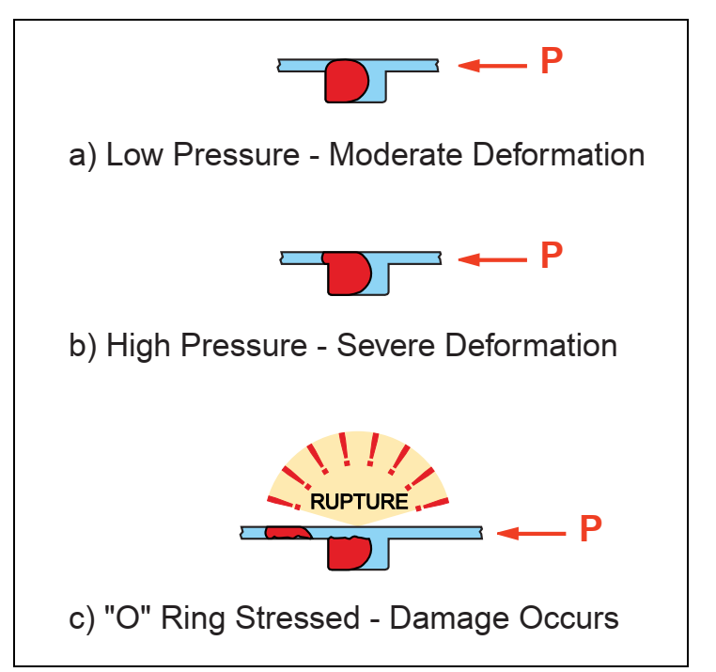
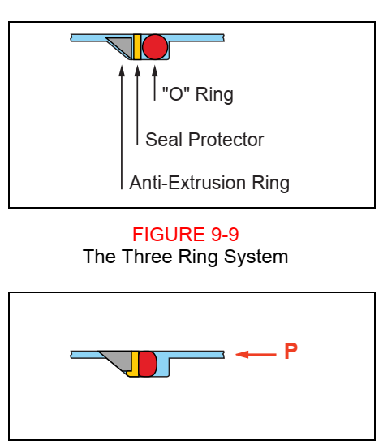
O-Ring Condition

Slide 33
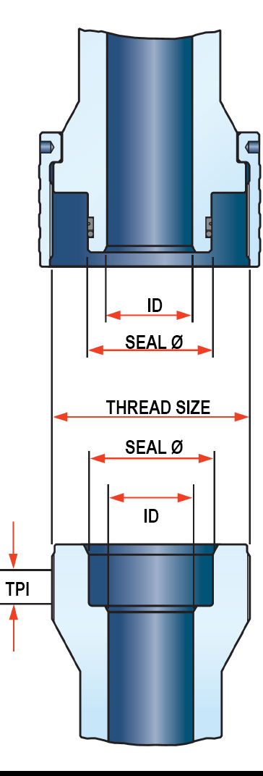
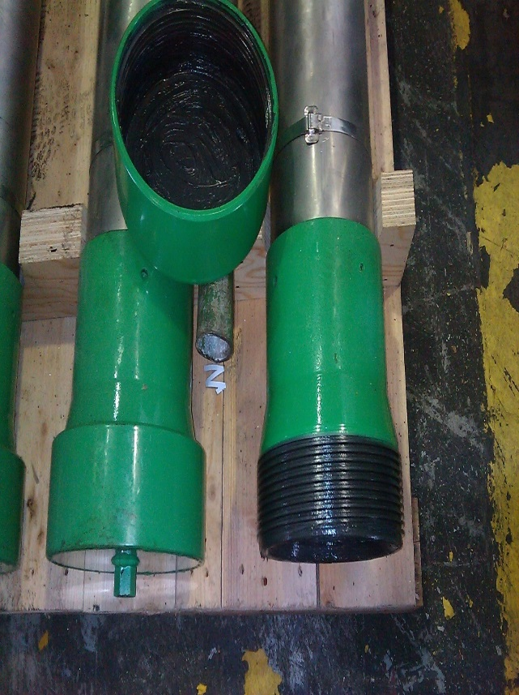
Quick Union (QU) Connections
There are THREE commonly used families of QU:
  Bowen QU (Code B)
  Otis Quick Unions (Code O)
  Elmar Quick Unions (Code E)
The three unions' families are not compatible.
Do not try to connect different QU without proper x-over / adapter.
The threads might be damaged if different QU is force to mate together.
PIN SECTION
BOX SECTION

Slide 34
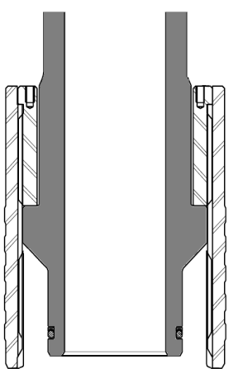
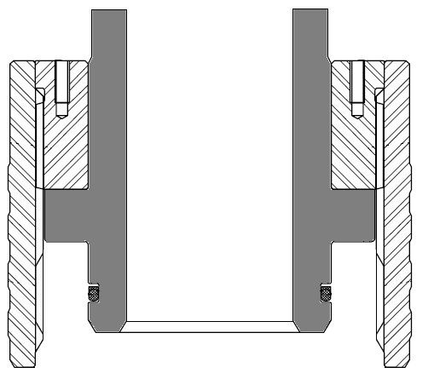
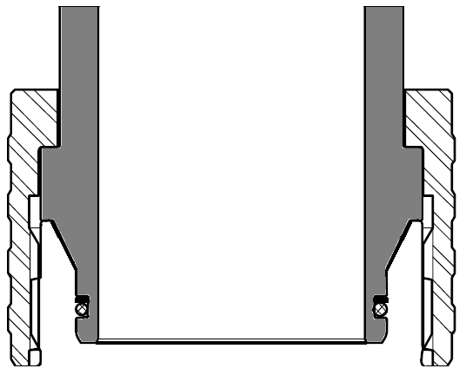
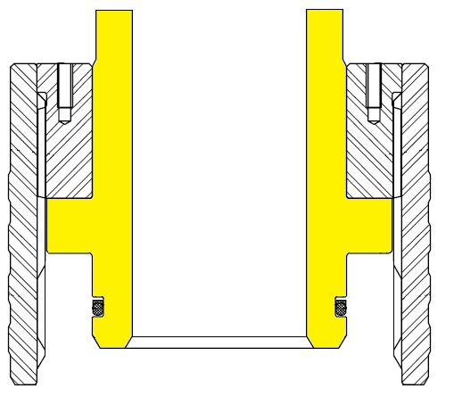
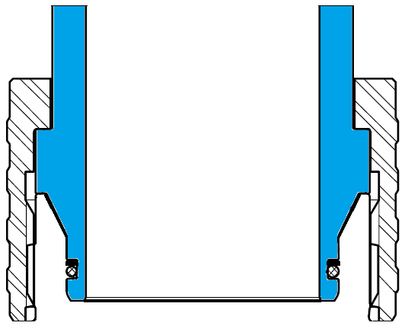
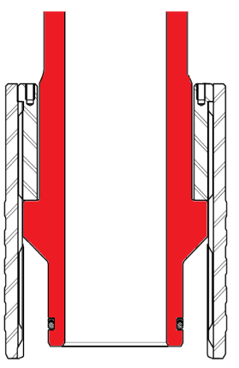
Type of QU Connections
OTIS QU
BOWEN QU
ELMAR QU

Slide 35
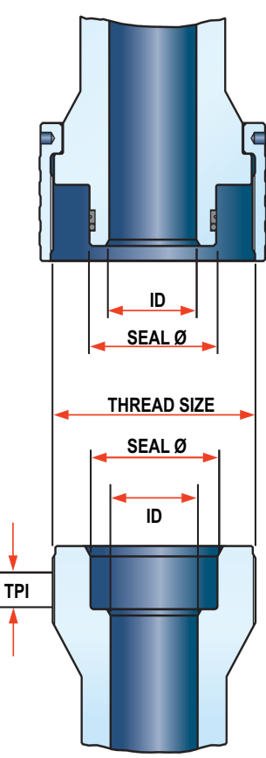
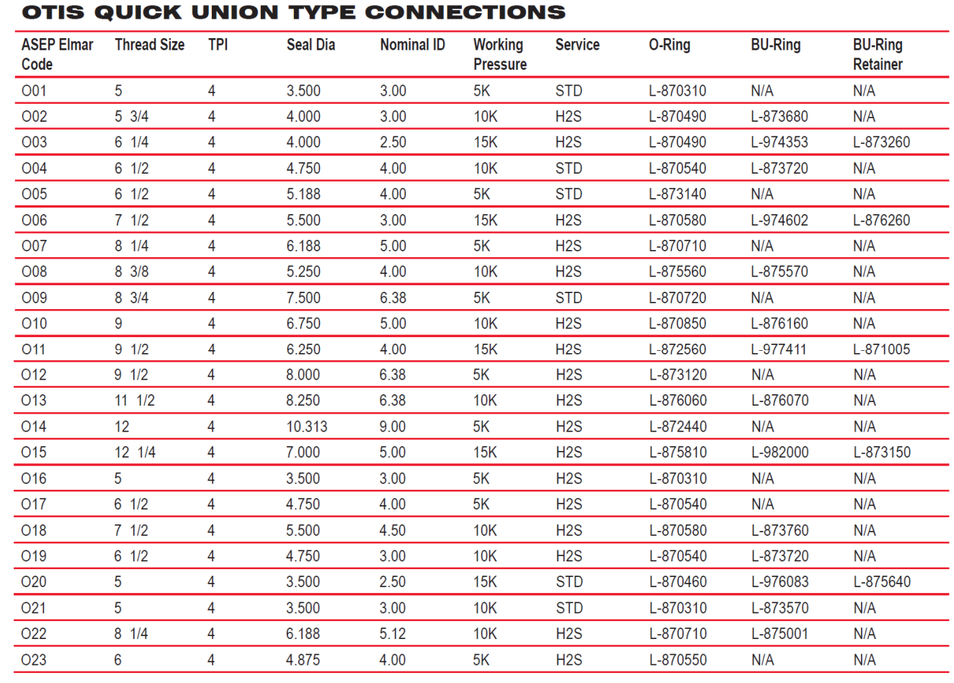
Type of QU Connections (OTIS)

Slide 36
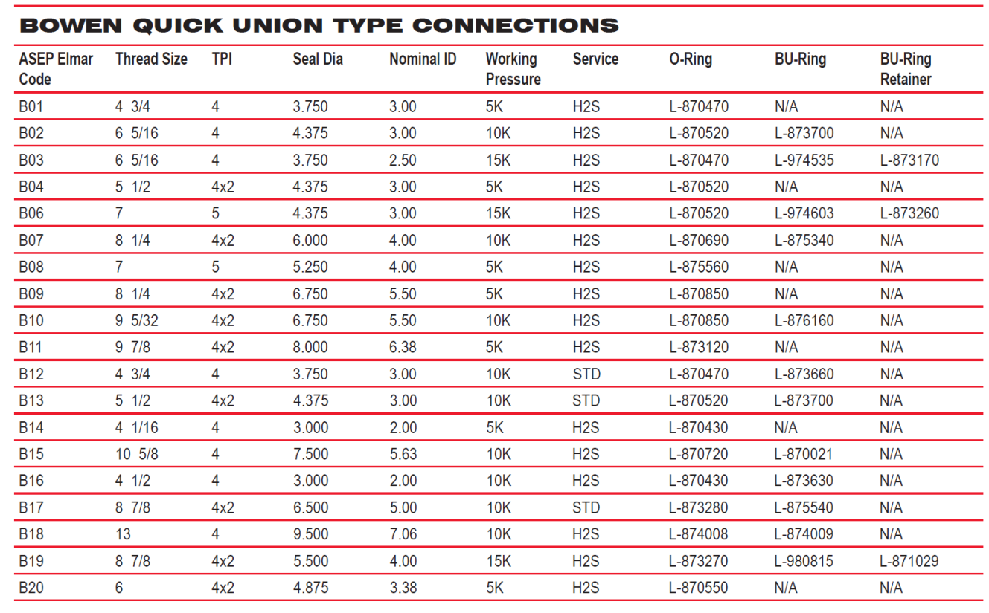
Type of QU Connections (BOWEN)

Slide 37
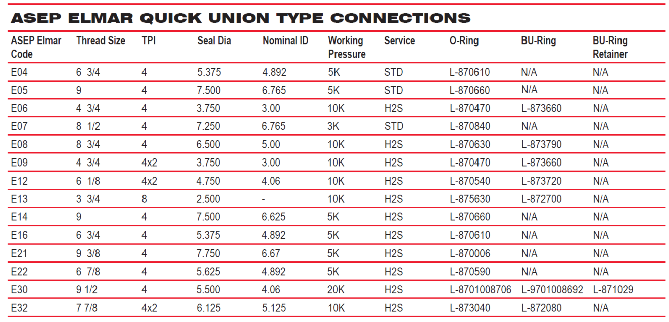
Type of QU Connections (ASEP ELMAR)

Slide 38
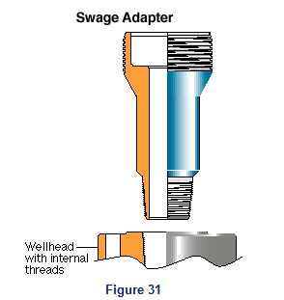
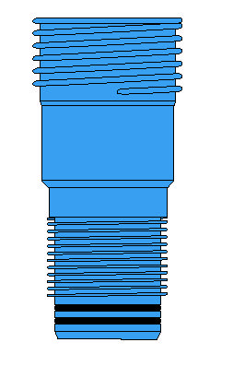
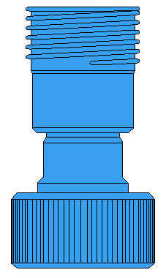
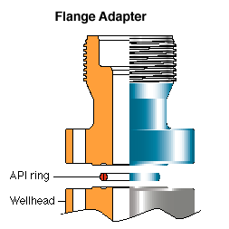
Well Head Connection
Stub Acme x-over
Quick union x quick union x-over

Slide 39
Flange Adaptor
Strongly recommended for all operations
Union box and API welded or integral frame
Safe only when all bolts of the proper grade (Grade B-7 with 2-H nuts) and size are used and torqued to API specs
Pressure rating depends on ring gasket design
Ring gaskets should be discarded after each use

Slide 40
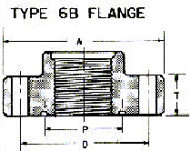



API 6A Flanges and Ring Joint Dimensions

Slide 41
SLICKLINE WELL BARRIERS

Slide 42
Slickline Operation Well Barriers
“Well Barriers” are defined as any device or element (wireline valve, lubricator, stuffing box, and grease injection head, etc.) that alone or in combination with other elements is capable of containing well pressure and preventing uncontrolled flow of fluids or gases from the formation, into another formation or to the surface or environment.
Please note that client “Pressure Barriers” normally refer to sealing valves or systems in the x-mas tree or completion.
A well barrier does not imply that it must be active at all times. It must however be operational, installed in the initial equipment rig up and ready to be used at all times (e.g. Wireline Valve).
The number and type of well barriers required is determined by the well conditions.

Slide 43
Slickline Operation Well Barriers
Active Well Barriers – (Stuffing Box, Liquid Seal Head, Pack Off, Grease Injection Head), capable to seal on Slickline or Braided Line/Stranded Line at all times, while tools are stationary or moving.
Passive Well Barriers – The Wireline Valve provides facilities for contingency and emergency procedures and must be included in all rig-ups. Is capable to offer the necessary conditions for repairing the active well barriers (Stuffing Box, Grease Injection Head, etc.) while the wire/cable is stationary.
Ultimate Well Barrier - (Shear/Seal rams, Xmas tree valves), A well barrier that is defined as the last and ultimate defense should the Active Well barrier and subsequent Passive Well Barriers fail.

Slide 44




Well Barriers for Slickline - 1
Slickline operations with WP rated equipment up to, and including 10K and no H2S, must use 2 well barriers i.e.:
(Active) Stuffing Box
(Passive) Single Manual Ram Wireline Valve.
(A Hydraulic Ram Wireline Valve is recommended)
Active Well Barrier
Passive Well Barrier
Ultimate Well Barrier
Shear-Seal / Tree Valve

Slide 45

Well Barriers for Slickline - 2
Slickline operations with WP rated equipment of 15K and 20K and no H2S, must use 3 surface barriers i.e.:
(Active) Stuffing Box
(Passive) Dual Hydraulic Ram Wireline Valve..
(A Hydraulic Ram Wireline Valve is recommended)
Active Well Barrier
Passive Well Barrier
Ultimate Well Barrier
Shear-Seal / Tree Valve

Slide 46
Well Barriers for Slickline - 3
Slickline operations with WP rated equipment of 5K, 10K, 15K and 20K and H2S, must use 3 surface barriers i.e.:
(Active) Stuffing Box
(Passive) Dual Hydraulic Ram Wireline Valve.
(A Hydraulic Ram Wireline Valve is recommended)
Active Well Barrier
Passive Well Barrier
Ultimate Well Barrier
Shear-Seal / Tree Valve

Slide 47
Scenario 1 – Normal Slickline Operation
(No contingency required)
Function | Barrier
Stuffing Box | Active when packing nut is activated
Wireline Valve/Slickline Rams | Passive
Shear/Seal Ram-Valve | Ultimate/Secondary

Slide 48
Scenario 2 – Slickline Operation
(Stuffing Box packing blown out during operations tool string below tree)
Function | Barrier
Stuffing Box | Active
Dual Wireline Valve/Slickline Rams | Top – Passive >> Active once it is activated Bottom – Passive
Shear/Seal Ram-Valve | Ultimate/Secondary

Slide 49

Scenario 3 – Slickline Operation
(Seal lost during operations tool string below tree)
Function | Barrier
Stuffing Box | Passive >> Active once it is activated
Liquid Seal Head | Active
Dual Wireline Valve/Slickline Rams | Passive
Shear/Seal Ram-Valve | Ultimate/Secondary

Slide 50
Surface Barrier Policy
Stuffing box = 1 surface barrier
Grease injection head = 1 surface barrier
Single ram SL BOP = 1 surface barrier
Dual ram (inverted) BOP = 1 surface barrier
Dual ram SL BOP = 2 surface barriers
Triple ram (inverted) BOP = 2 surface barriers
Policy differs between Slickline and Stranded Cable equipment.
Barriers relate to WP rating of equipment selected for the operation.
BOP selection defined Downhole Safety Valves (DHSV) cannot be used as a surface barrier even during long tool string operations.

Slide 51
EQUIPMENT
IDENTIFICATION

Slide 52
Equipment Identification
Each item of pressure containing equipment shall be stamped on structurally non-critical area or on a permanently attached metal band or ring
Mandatory information:
  Manufacturer’s identification code or DB asset code
  Serial number or item number and manufacturer’s part number
  Service type (standard or H₂S)
  Working pressure rating and test pressure rating
  Date of manufacture
  Date of last pressure test

Slide 53
CERTIFICATION

Slide 54
CERTIFICATION
All Dimension Bid - owned PCE shall be initially qualified by an inspection and hydrostatic test at reception and verified at regular intervals during Annual Survey.
The hydrostatic body test shall be conducted at rated Test Pressure, TP. Hydrostatic seal tests for valves (BOPs) and operating tests shall be conducted at rated Working Pressure, WP.
All pressure-containing equipment should undergo a Major Recertification every FIVE (5) years

Slide 55
PRESSURE TEST CERTIFICATES
The Pressure Test certificates must include:
Pressure test date and test pressure.
Test type (body, operational) and test fluid.
Asset identification.
Name of person performing the test.
Signature of person performing or supervising the test.

Slide 56
Annual Inspection
Annual inspection minimum frequency is once a year and consist as a minimum of the following operations:
  Review Asset History File
  All components of each item must be disassembled and inspected for damage and corrosion.
  Any element showing cracks or surface defects must be replaced.
  All O-Rings and pressure seals must be replaced.
  Hydraulic fluids must be replaced.
  A Hydrostatic body pressure test to Test Pressure (TP) must be performed.
  An operational pressure test to Working Pressure (WP) must be performed for Wireline Valves, Stuffing Box, and Pack Off’s.

Slide 57
Major Re-Certifications
All PCE must undergo a major Re-Certification every five years according to the following procedure.
  A visual inspection.
  All threads and sealing surfaces must be checked for any damage.
  A strip down of mechanical parts in line with the equipment maintenance manual.
  Random thickness tests on lubricators, wireline valves, tool trap, ball check valve, tool catchers and crossover bodies using Non Destructive Examination (NDE) methods. Test report needs to be generated.
  A crack test using a dye penetrate or MPI.
  A Hydrostatic Body Test to Test Pressure (TP).
  Operating Test to Working Pressure (WP).

Slide 58
Inspection and Pressure Test Procedures
Pressure test must be performed with water or test fluid.
All air must be bled from the system.
Hydrostatic body test (TP), pressure is introduced slowly to TP value, hold for 3 minutes once it has stabilized.
Bleed pressure down to zero.
Introduce pressure slowly to TP, hold for 15 minutes once pressure has stabilized.
Bleed pressure down to zero.
Operational test to (WP), (cable rams) must be perform with specifically designed test rods.
The assembled equipment is pressurized to WP, moving systems are operated and rams or packing is tested.
Equipment with moving parts (Rams) must be operate to ensure they function properly.

Slide 59
Working & Test Pressure
All pressure control equipment used by Slickline Services must be pressure rated.
It is forbidden during wellsite operations to submit any piece of pressure control equipment to a pressure higher than its Working Pressure (WP) rating.
In a rig up of different components, the Working Pressure (WP) of the lowest rated component gives the overall working pressure rating of the system.
The equipment manufacturers assign Working Pressure and Test Pressure ratings to all pressure control equipment.

Slide 60
Working & Test Pressure
Working Pressure (PSI) | Multiplier | Test Pressure (PSI) | Remarks
5000 | x 2 | 10,000
10,000 | x 1.5 | 15,000
15,000 | x 1.5 | 22,500
20,000 | x 1.5 | 30,000
Slickline Services PCE must have a minimum Working Pressure (WP) rating of 5000 psi

Slide 61
WELLSITE
PRESSURE TESTING

Slide 62
Wellsite Pressure Testing
Two descriptions apply during wellsite pressure testing, surface induced and well induced.
Surface induced pressure testing can only be performed with:
  Cannot use a flammable fluid
  Water and or Water and Glycol Mixture
  40-60 methanol – water, mixture is tolerated.
Hose equalization performed, using a hose bypassing the swab valve.
If pressure introduced using the swab – the maximum build up rate must be 1000 psi / minute.
When well induced pressure testing is performed - a pressure test of the PCE to WP, must have been performed in the last quarter, as 1.2 x MPWHP cannot be obtained.
Well induced pressure testing (well fluids used) can only be performed if all the following criteria are met:
  Cased hole operation/ known field
  MPWHP has been reached and is less then 5000psi
  No H2S present

Slide 63
Wellsite Pressure Testing
Work to the lowest pressure rated piece of equipment.
The wellsite test pressure must never exceed the equipment working pressure rating or the client wellhead working pressure rating.
PCE must be pressure tested after it has been rigged up and before opening the well for the first time.
DB’s operator and WSS must be present during pressure test.
Stand in protected position when applying pressure.
NPT threads – wear monitoring / thread tape application.
Never hammer the equipment when under pressure.
Reduces potential exposure to high pressure situations.
High volume pumps may rapidly exceeded the WP rating of the pressure control equipment.
Pressure testing with high volume rig, coil tubing, and cement pumps is strongly discouraged.
Pressure test pumps should be limited - low pressure high volume 80 l/m up to 400psi then 4 l/m up to 15000 psi. and more.
Two gauges must be active – at pump outlet and the PCE.

Slide 64
Wellsite Pressure Testing
Wellsite test pressure must be 1.2 times the expected maximum potential wellhead pressure.
Example:
MPWHP = 1200 psi. no H2S
1200 x 1.2 = 1440 psi. is your test pressure.
5K WP pressure control equipment standard service can be used.
1440 psi will be the minimum pressure used to test the equipment.
If you only test to 1440 psi this will be your MAOP.
If for some reason during the operation the MPWHP becomes >1440 psi.
You will need to re – test x 1.2.

Slide 65
Wellsite Pressure Testing
(for Explosive Services)
Pressure testing with loaded guns in the lubricator/riser is forbidden.
Quick test sub must be installed at position of break point.
Rig up and pressure test with dummy gun, bleed of and break quick connection, introduce gun string, test quick connection.

Slide 66
SAFETY
CONSIDERATION

Slide 67
Safety Consideration
Perform PRESSURE TEST after all equipment has been connected & before the job begin.
Conduct Pressure Test using water only and Glycol.
Flush the entire system to eliminate air.
At wellsite a Pressure Test is performed at a maximum of 100% of the Working pressure of relevant equipment only.

Slide 68
PCE General Safety Rules
Do not cut, bore or modify
Do not hammer on
Do not stamp
  Use metal bands
  DOT stamp OK
Do not weld or heat
Do not perform shop pressure tests beyond TP
  Calibrate gauges
  Use chart recorder

Slide 69
SUMMARY

Slide 70
Summary
Dimension Bid must ensure that all operational pressure controlling equipment is qualified for its intended use and that the equipment is never used outside its design parameters or specifications.
Equipment failure caused by non-compliance to defined standards (poor or non-existing maintenance/certification renewal) or equipment used outside its operating envelope can have severe consequences.
Failure of pressure containing equipment can cause substantial damage to property and can cause fatalities of both Client and Dimension Bid’s personnel.
These types of failures might be considered as gross negligence and could make Dimension Bid responsible and potentially liable for losses.

Slide 71
References
International Well Control Forum (IWCF) Notes
PTTCO Ltd. (2005). 02P Principles and Procedures. Bangkok, Thailand
Joseph Olaiya- Schlumberger. (2016). Completion Pressure Control Equipment
Middle East Learning Center (MLC), Abu Dhabi, UAE.
Schlumberger Slides Presentation
Remi Chesnel - Schlumberger. (2015). 3- Pressure Control Equipment_W. Indonesia Training Center (ITC), Jakarta, Indonesia.
SKG 2018 Slide Presentation
Dimension Bid Sdn. Bhd. (2018). Module03 Pressure Controlled Equipment. Dimension Bid WH 22, Kemaman, Malaysia.

Slide 72
Q&A

