Slide 1
HSSE SHARING
By Ikram Muslim

Slide 2
Monthly Safety Sharing Internal DB
1. Importance of Lifting Ergonomics
Efficiency
Quality
Safety
Health
Work Comfort
2. Impact of Lifting Ergonomics Negligence
Acute injuries – ankle sprains, hamstring
Chronic injuries – spine & disc disorder
4. Guidelines for Lifting Manual
Lifting / Lowering
Pushing / Pulling
Handling in seated position
Carrying
3. Hazard Identification
Onshore Hazard Hunt E-Card
Observation / walk through survey
Notes:
Negligence = carelessness

Slide 3
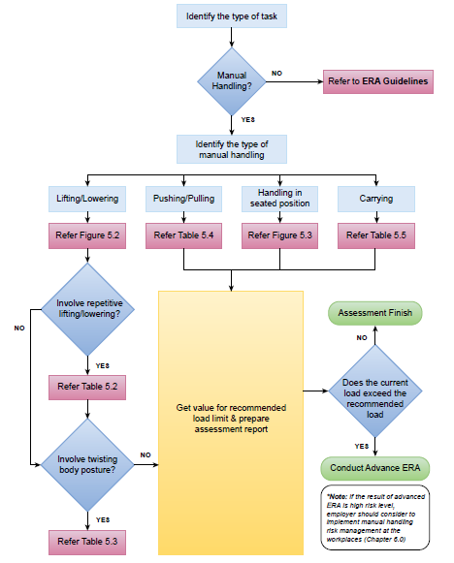
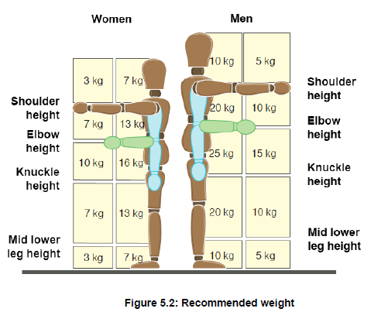
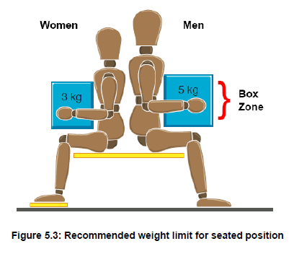
Monthly Safety Sharing Internal DB
Notes:
ERA = Ergonomics Risk Assessment

Slide 4
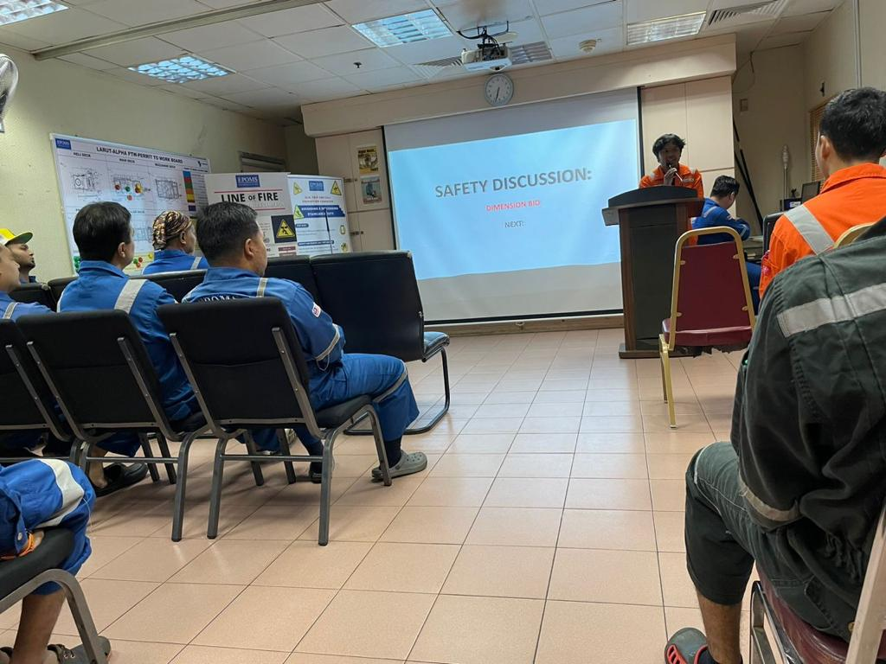
Safety Sharing Offshore
Notes:
ERA = Ergonomics Risk Assessment

Slide 5

Thank you !
Questions and Answering Session
© Neu Dimension 2020

Slide 6
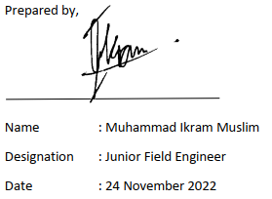
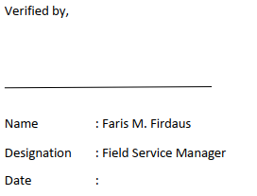
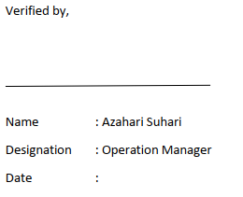
© Neu Dimension 2020

