Slide 1
Kick Over Tools
MALKYZIDEK YEHU JERRY

Slide 2
Contents :
Type kick over tools
Kick over tools(OK6)
Ok6 parts
How to pinning OK6
OK6 sequence
Running tool
Pulling tools

Slide 3
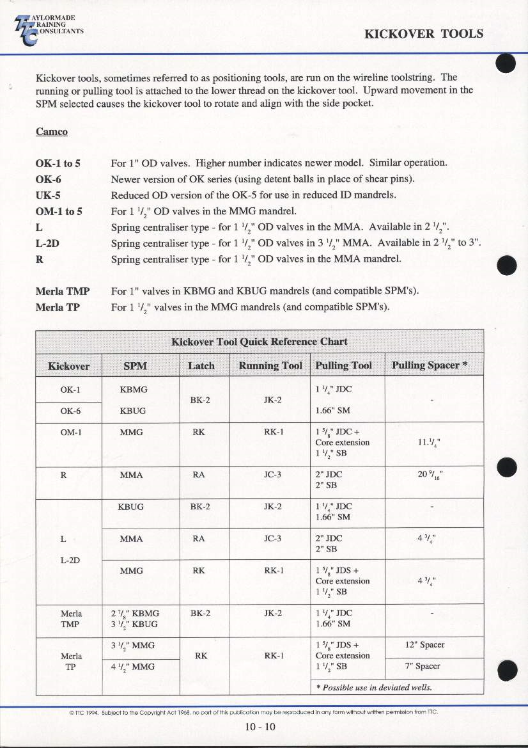
Type off kick over tools

Slide 4
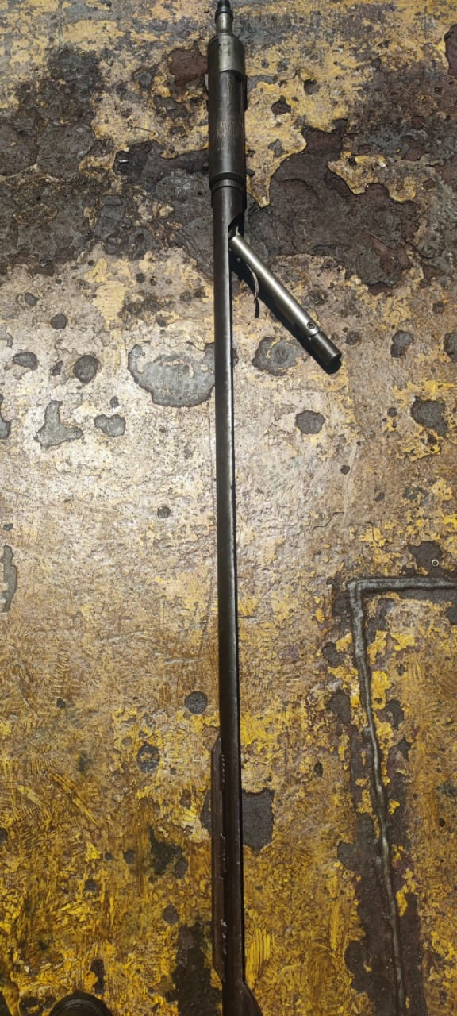
Kick over tool(0K6)
Initially a Camco design
For 1” valves
OK series : OK 6
Built in catcher
Re-pin trigger each run

Slide 5
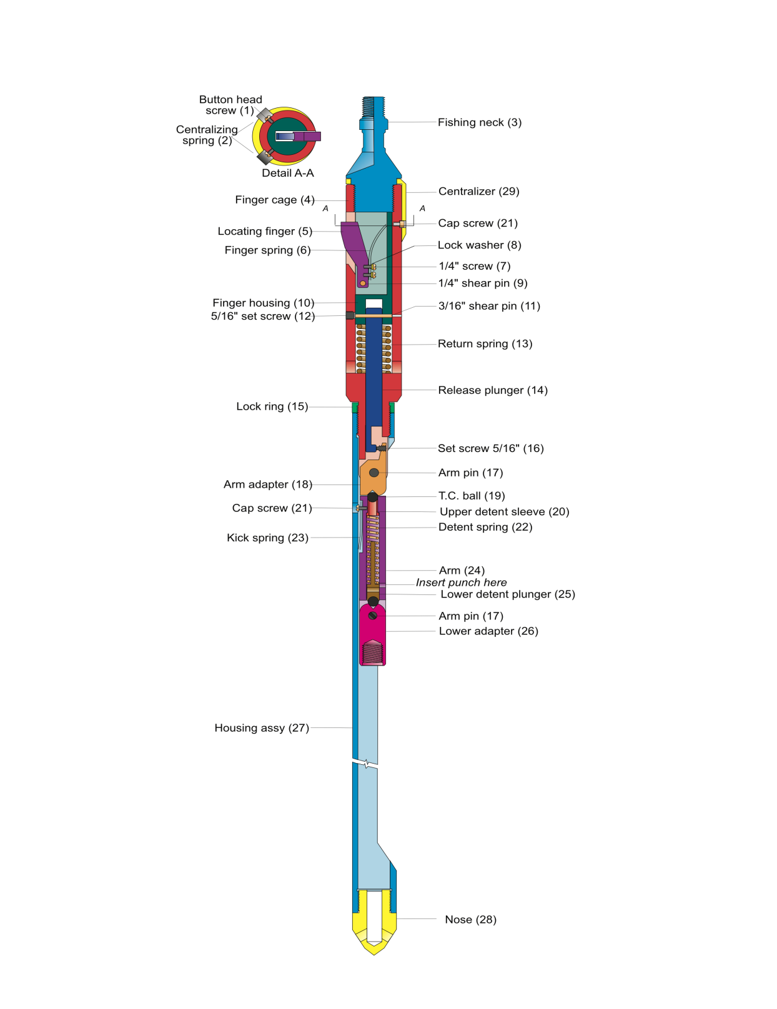

Slide 6
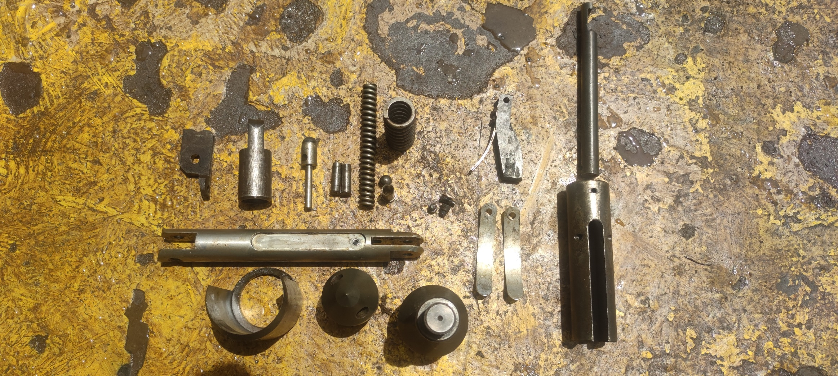

Slide 7
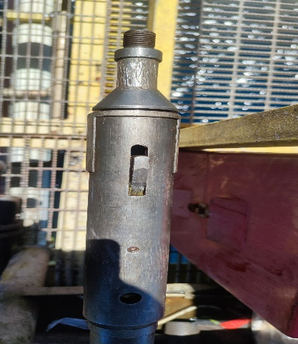
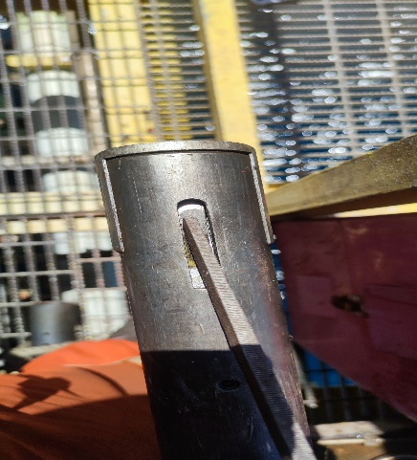
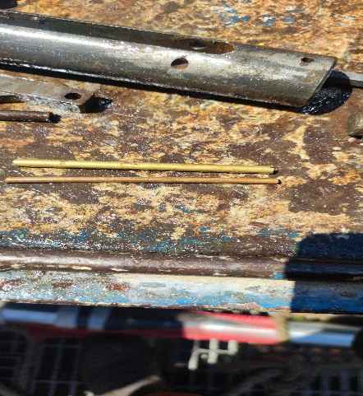
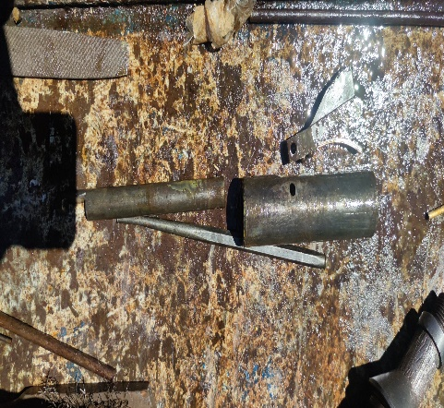
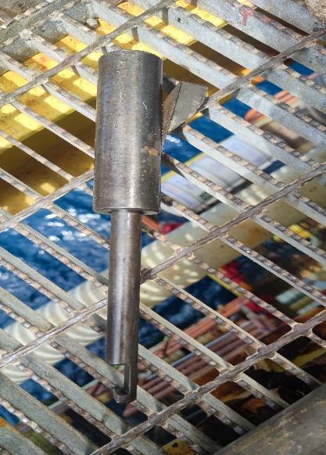
Important
Shear pins must be either free cutting brass(ASTM specification B16 half-hard)or aluminum alloy 5052 with H38 temper. If the shear pin made of anything harder, the kick over tool could be damaged or the pins might not shear.(pin size 3/16-1/4)

Slide 8
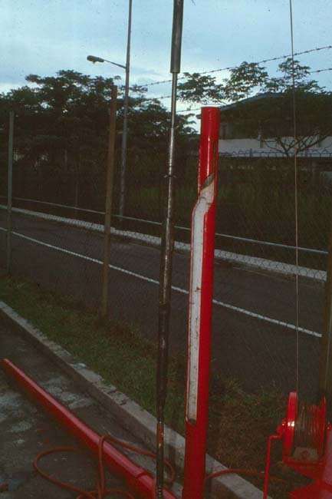
OK sequence 1
Valve pinned to running tool
Running tool attached to Kickover Tool
Kickover tool pinned and straight

Slide 9
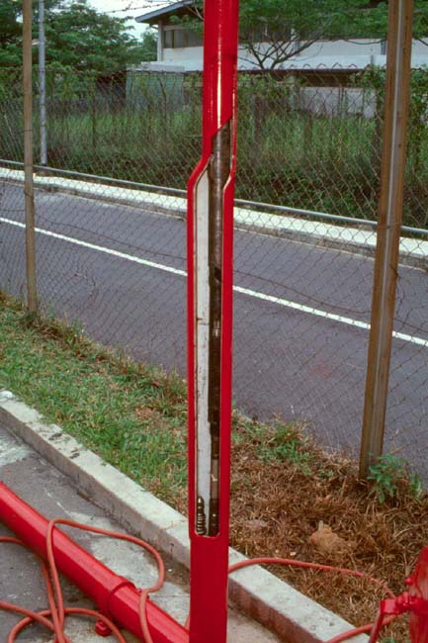
OK sequence 2
RIH
Pass thru SPM’s
Pass thru target SPM

Slide 10
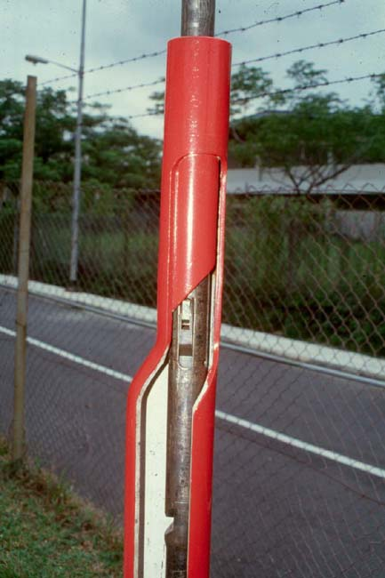
OK sequence 3
Trigger orients in sleeve
Turns tool to align over pocket

Slide 11
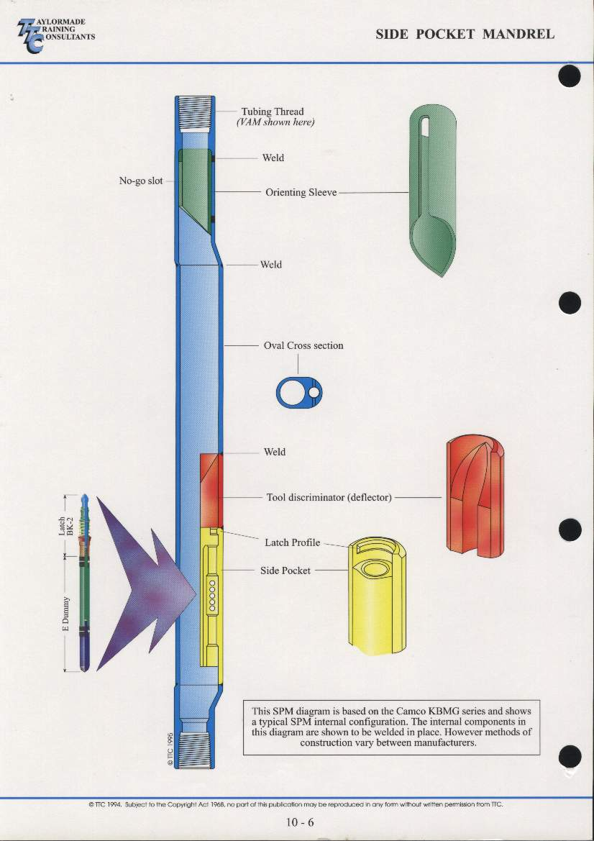

Slide 12
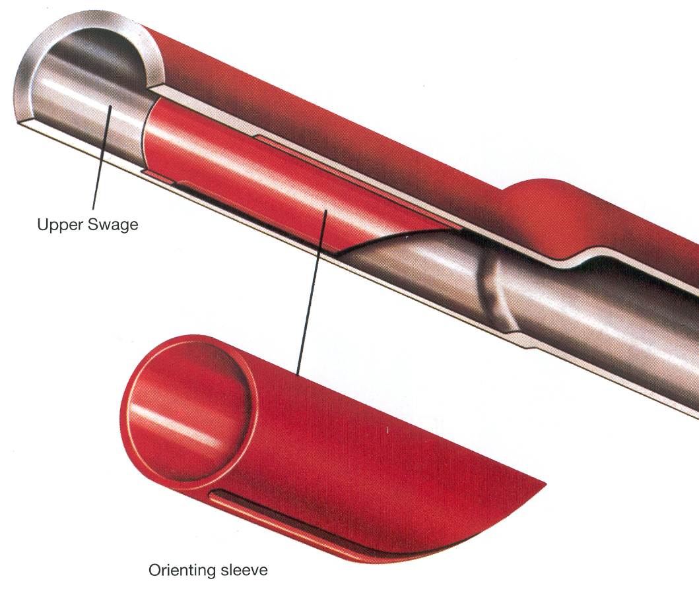
Orienting sleeve

Slide 13
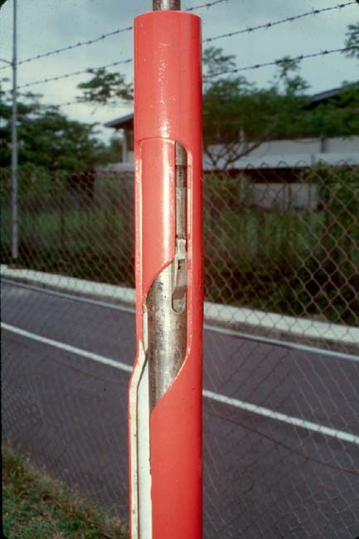
OK sequence 4
Trigger moves up orienting slot
At top – force is applied
Tools “kicks over”

Slide 14
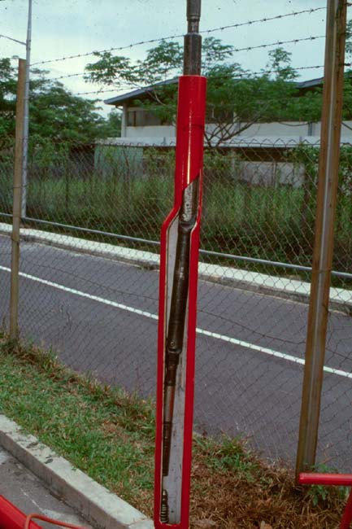
OK sequence 5
Valve – or pulling tool (shown) aligned over pocket

Slide 15
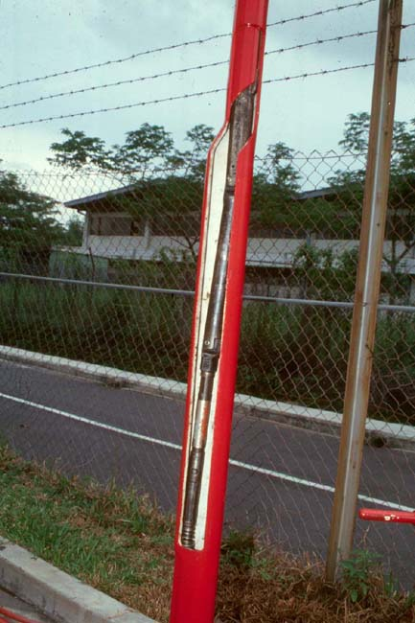
OK sequence 6
Tools lowered onto valve (or into pocket)
Tap down to position valve
Or Jar up to pull valve

Slide 16
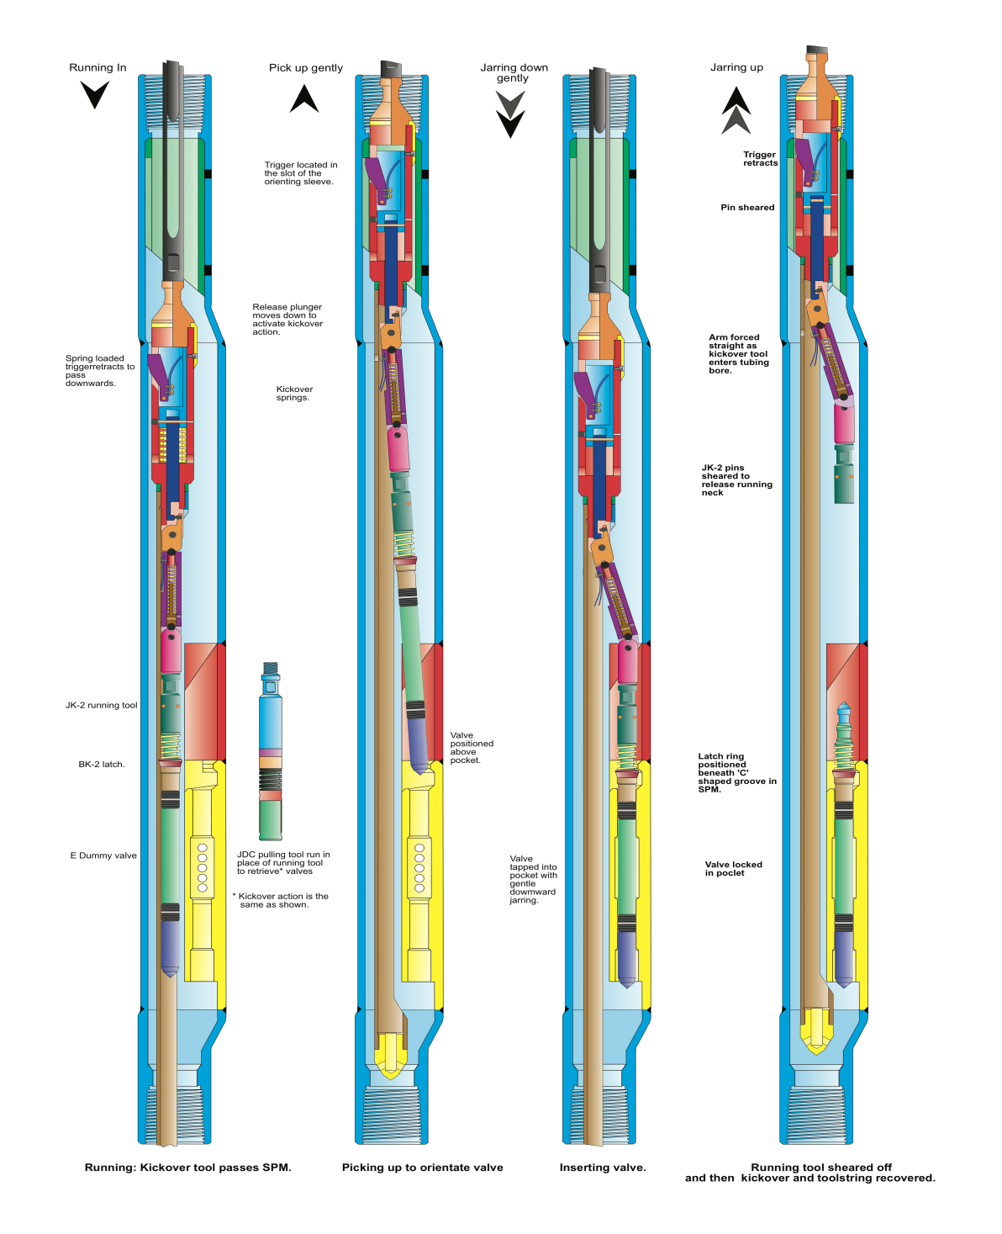

Slide 17
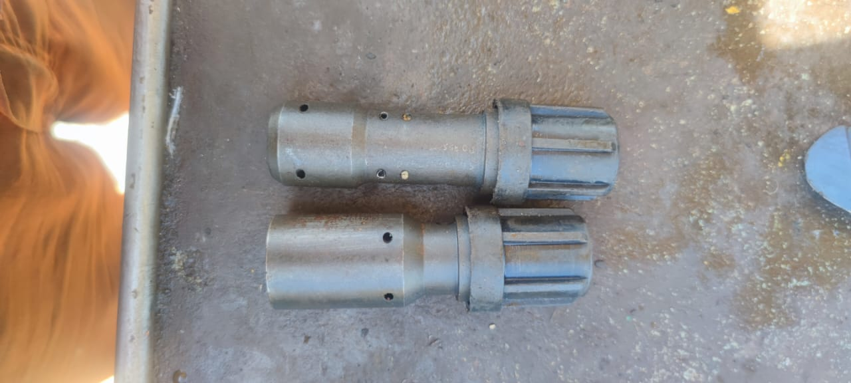
Gas lift running tool
GA-2
- Bottom latch
JK-1
- Top latch

Slide 18
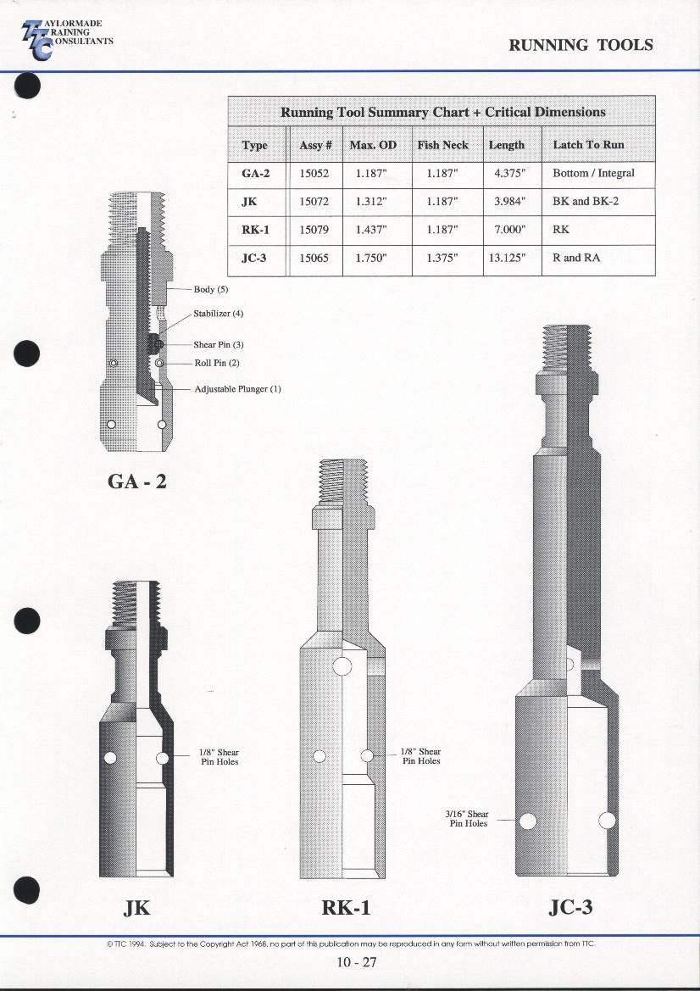

Slide 19
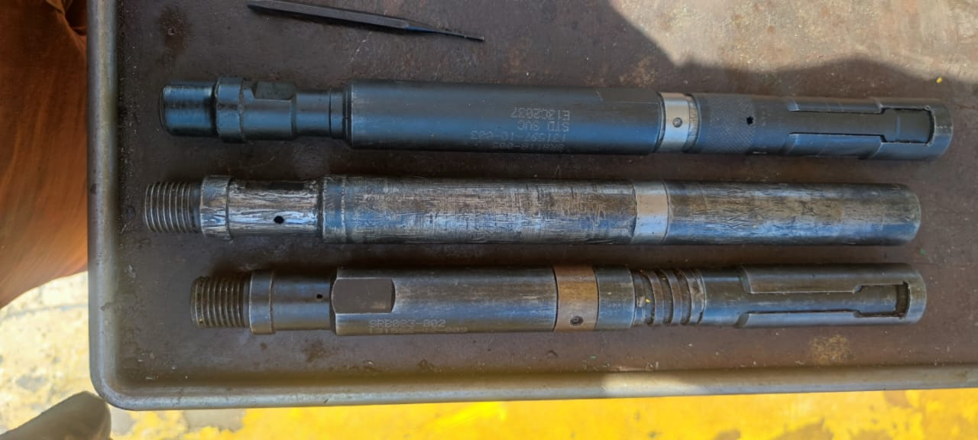
Pulling tools

Slide 20


